Slide 1

I would like to take time to acknowledge that we are giving this presentation on land that was once home to the Mingo Seneca people and was taken from them by force and disregard for their future.

Slide 2

Presented by Adriana Jurado, Rachel Mulholland & Joan Soulliere
The Hartford Partnership Program for Aging Fellowship, University of Pittsburgh, School of Social Work.

Slide 3
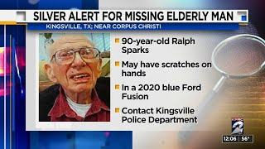
The Silver Alert: Locating Our Missing Elderly
Statewide public alert for missing adults
Over the age of 65
Dementias and cognitive difficulties
Parentgiving, Inc. (n.d.). Silver Alert System | Elderly Safety. https://www.parentgiving.com/elder-care/the-silver-alert-system-finding-our-missing-elderly/

Slide 4
Why is the Silver Alert System Needed?
According to the National Alzheimer’s Association:
6 out of 10 people with Alzheimer’s disease will wander from their homes of caregiving facilities
If not found within a 24-hour period, up to half will suffer serious injury or death.
A person living with Alzheimer’s or other dementias can become lost or disoriented in their own neighborhood and familiar places.
https://www.alz.org/news/2008/alzheimers-association-statement-on-silver-alertt
Notes:
Rachel
A system that addresses the need for quick action around this vulnerable population is critical for keeping them safe, as well as finding them in a timely manner if they do wander or get lost

Slide 5
Is the Silver Alert System Effective?
35 States have a Silver Alert System.
Texas was one of the first States to adopt the Silver Alert System.
Between 2007 and 2017: 789 activations -- 740 times, the person was found during the alert. That's a 94% success rate.
Data needs to be extrapolated because each State is responsible for implementing its own Silver Alert System. According to the Silver Alert Coalition, State information is not aggregated and there is not data accounting for people who have wandered repeatedly.
https://www.wfaa.com/article/news/verify/verify-do-silver-alerts-work/287-481452421#:~:text=Since%202007%2C%20when%20the%20alerts,the%20same%20person%20goes%20missing.
Notes:
Rachel
This success rate is critical to note because of the way the information is disseminated to the public in various ways, and very quickly

Slide 6
What PA Currently Has
Missing Endangered Person Advisory System (MEPAS)
  Public education problem / Not well known by the public
  For all adults over 21 years old / No distinction for elderly
Barriers to Silver Alert in PA - Legislative inertia
https://keystoneelderlaw.com/silver-alert/

Slide 7
2010
2004
2022
Legislative Milestones
Governor Rendell signed Senate Bill 976 into law, which added managing the MEPAS to the Pennsylvania State Police duties in addition to maintenance of the Amber Alert system.
P.L.1270, No.153 PA Amber Alert System Law enacted.
Senate Bill 1180, introduced by Senator Patrick Browne (R), would modify the State's Amber Alert law to create a "Silver Alert System." Sitting in Committee. Browne is now PA Secretary of Revenue.
https://keystoneelderlaw.com/silver-alert/

Slide 8

What We Did
Presentation
Created an informational presentation to share and record
Education
Provided informational handout and recommended resources and options for further learning after our presentation
Social Media
Created and posted content about the SilverAlert to raise awareness

Slide 9
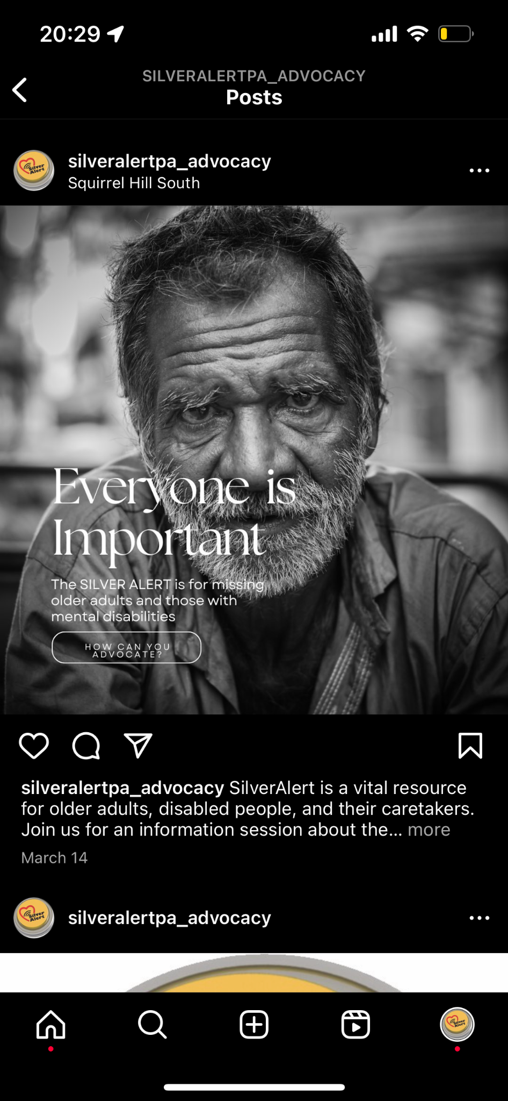
Social Media
Examples
Created and managed a public Instagram account dedicated to highlighting SliverAlert and our event
Metrics:
8 followers -- all community organizations,
2 instagram like total
Analysis:
Low engagement,
Did not spend enough time building social media outreach

Slide 10
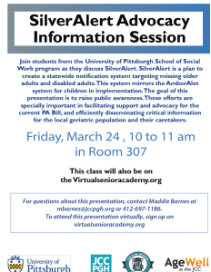
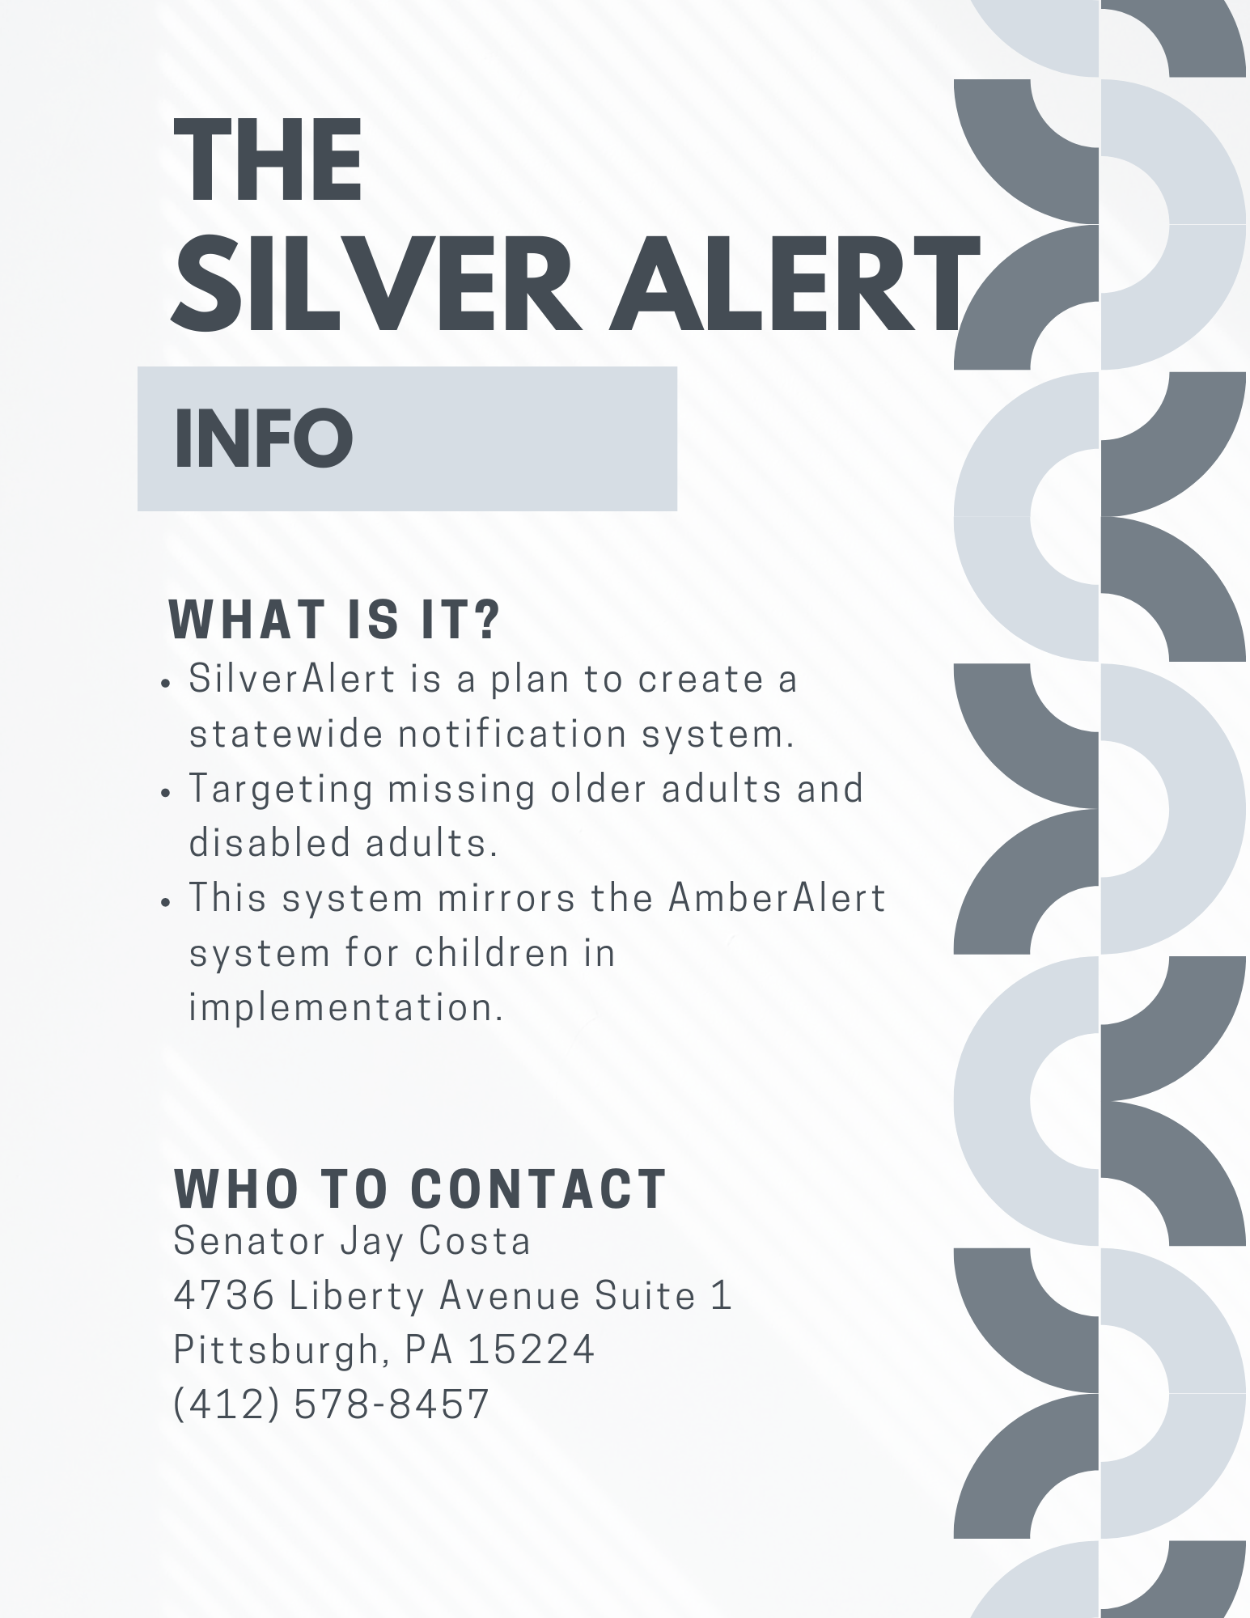
Event
What?
  SilverAlert Advocacy Information Session
Who?
  Older adults who use the JCC or the VSA
Where?
  In the JCC, Room 307, or on Zoom via the VSA
How?
  Provided a handout to participants
  Provided resources and ideas for further learning and advocating

Slide 11
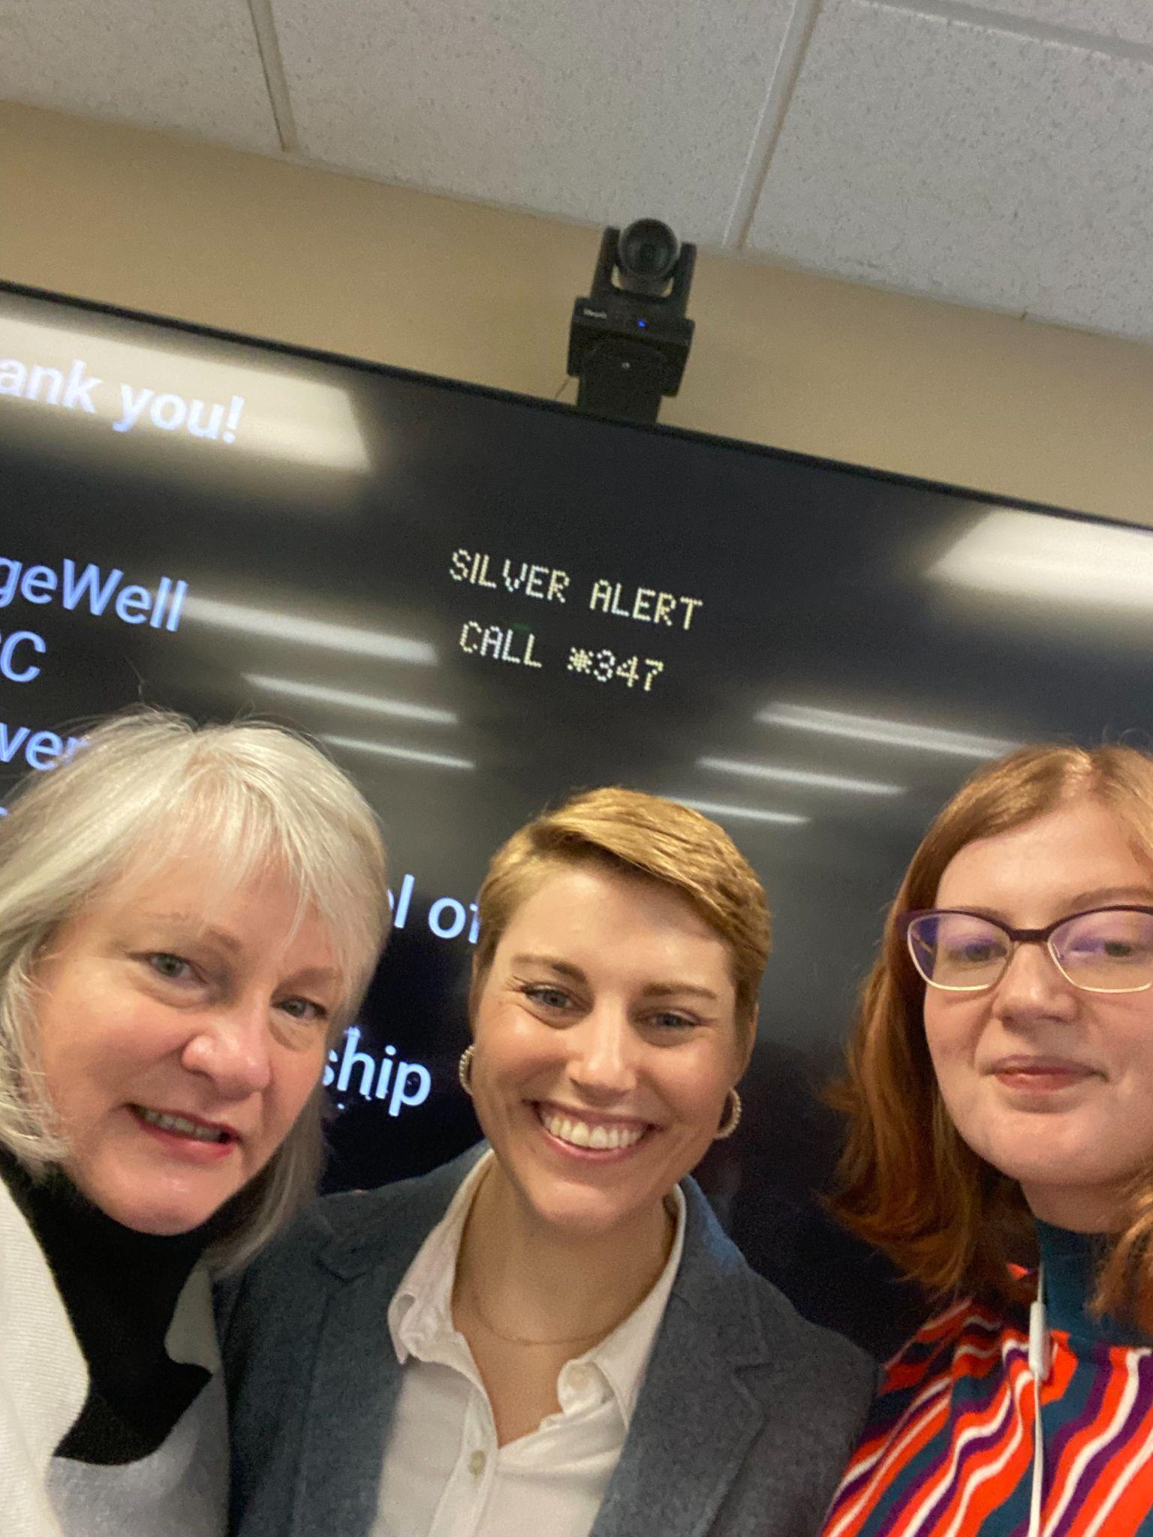
Challenges
Small audience but engaging
  1 in person, 1 on zoom
Tech issues
Identifying stakeholders
Takeaways
Earlier promotion of event
Working with advocacy organizations to partner with to draw on their audience and expertise

Slide 12
Take Action
Learn
Read, write, and utilize resources like the Area Agency on Aging,
Advocacy Tool
Provided a one-pager to audience members, reminding them what SilverAlert is and the contact information for the State Senator.
Practical Advocacy
Identified ways to advocate inside Community with friends and neighbors, identified spaces of influence such as church and community centers
Notes:
Rachel
-utilize local resources, books, articles, websites and seminars to learn about the topic
-writing to your local state senator to push for the current bill is one of the best ways to advocate. You can work to inform others as well
-older adults who are passionate about politics, caregivers, family members, and local organizations are all places to influence and advance knowledge about the SilverAlert, its need in PA, and pushing it through legislation.

Slide 13
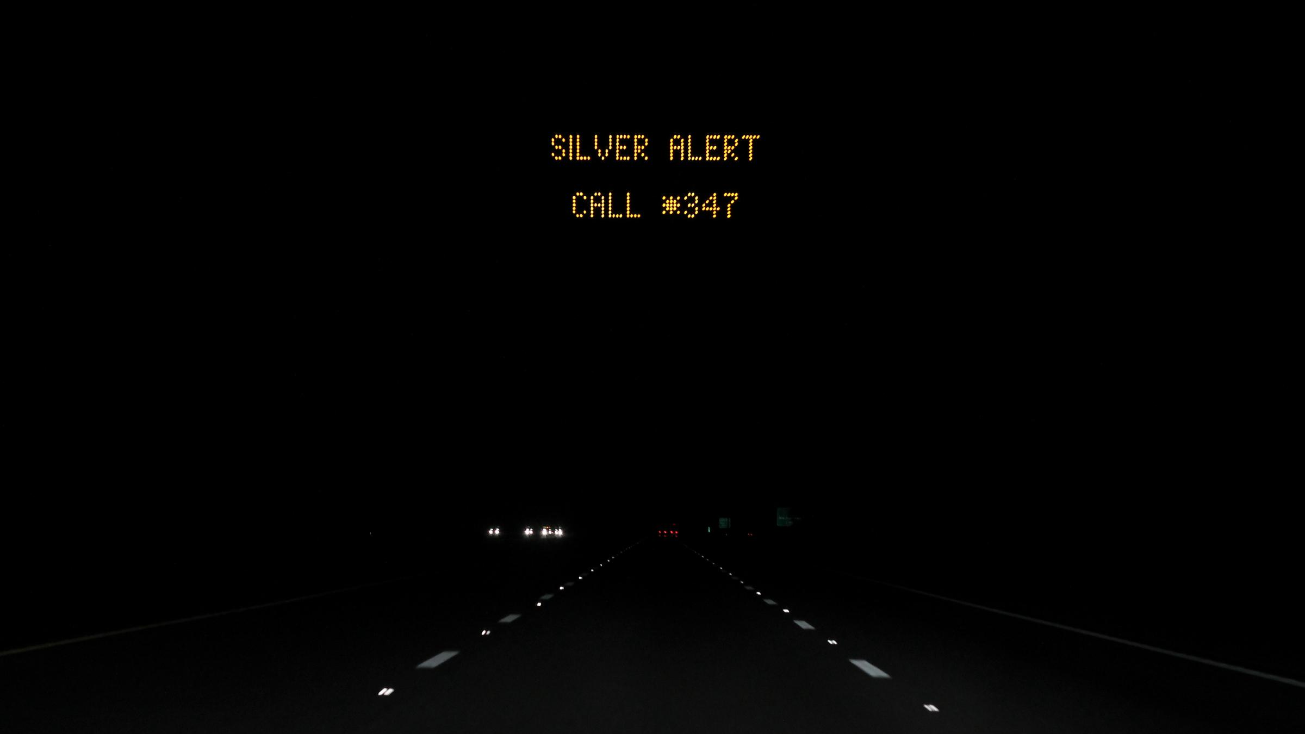
The road to advocacy starts with you!

Slide 14
Thank you!
Adriana Jurado
amj144@pitt.edu
Joan Soulliere
jls492@pitt.edu
Rachel Mulholland
rem192@pitt.edu

