Slide 1
COMMUNITY ENGAGEMENT FELLOWSHIP
University of Pittsburgh Community Engagement Center / Bible Center Church
Kat Bakrania
Notes:
https://docs.google.com/spreadsheets/d/15rBD51c462sFcfulNj0QFYdfTnL7gx5unIPzHZFhSU4/edit#gid=2029492028

Slide 2
CAPACITY BUILDING
Neighborhood information, national STEAM programming examples, data collection, and more.
Pitt CEC in the Hill District
COMMUNICATIONS
Graphic design work and social media.
DIRECT ENGAGEMENT
Fall 2019
Community meetings and events.
Notes:
https://docs.google.com/spreadsheets/d/15rBD51c462sFcfulNj0QFYdfTnL7gx5unIPzHZFhSU4/edit#gid=2029492028

Slide 3
Flyer
Examples
Notes:
https://docs.google.com/spreadsheets/d/15rBD51c462sFcfulNj0QFYdfTnL7gx5unIPzHZFhSU4/edit#gid=2029492028

Slide 4
CAPACITY BUILDING
Grant support work, grant reports, foundation information gathering, and more.
Bible Center Church: The Oasis Project
PROGRAM ASSISTANCE
Better Food Better Me
Oasis Farm & Fishery: Community Supported Agriculture; Field to Fork.
Spring 2020
Notes:
https://docs.google.com/spreadsheets/d/15rBD51c462sFcfulNj0QFYdfTnL7gx5unIPzHZFhSU4/edit#gid=2029492028

Slide 5
Takeaways
Notes:
https://docs.google.com/spreadsheets/d/15rBD51c462sFcfulNj0QFYdfTnL7gx5unIPzHZFhSU4/edit#gid=2029492028

Slide 6
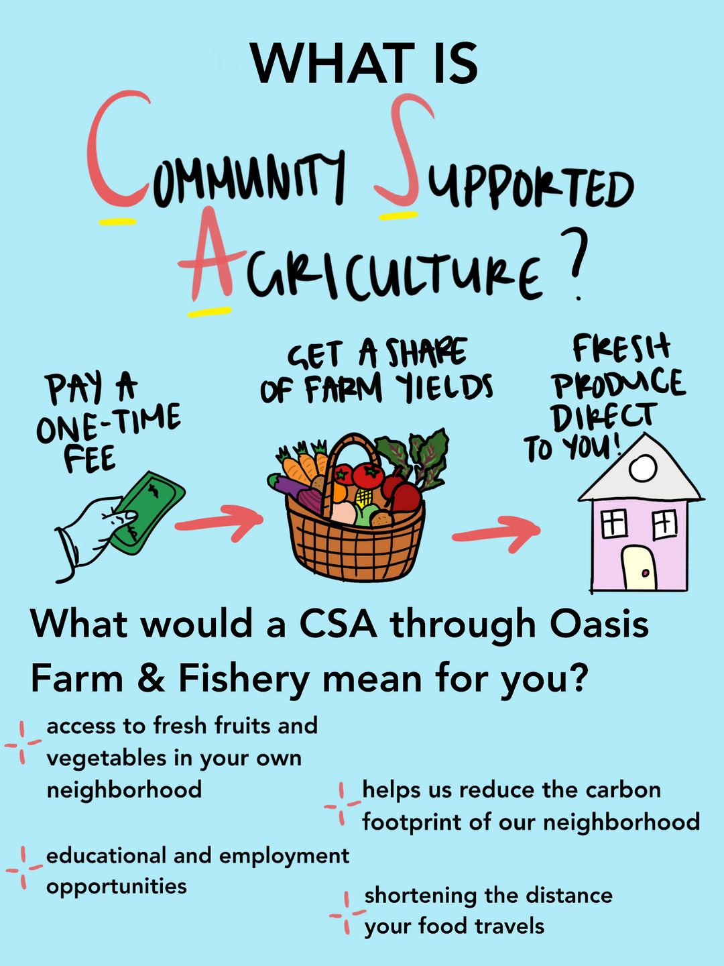
"H" Communities and need: Hazelwood Initiative, Hill District CEC, Bible Center.
There is always more to learn about the communities you serve.
Listen to understand, not just to respond.
Notes:
https://docs.google.com/spreadsheets/d/15rBD51c462sFcfulNj0QFYdfTnL7gx5unIPzHZFhSU4/edit#gid=2029492028

Slide 7
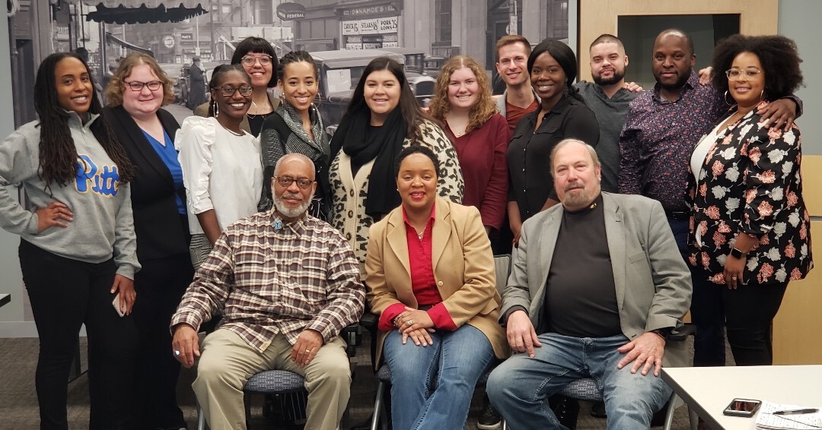
Thanks for your time!
Notes:
https://docs.google.com/spreadsheets/d/15rBD51c462sFcfulNj0QFYdfTnL7gx5unIPzHZFhSU4/edit#gid=2029492028

