Slide 1
Community Engagement Fellowship
MM
Morgan Overton

Slide 2
Field Placement
Office of State Representative Jake Wheatley Jr.
Serves District 19
Elected in 2003
Democratic Chairman of Finance Committee

Slide 3
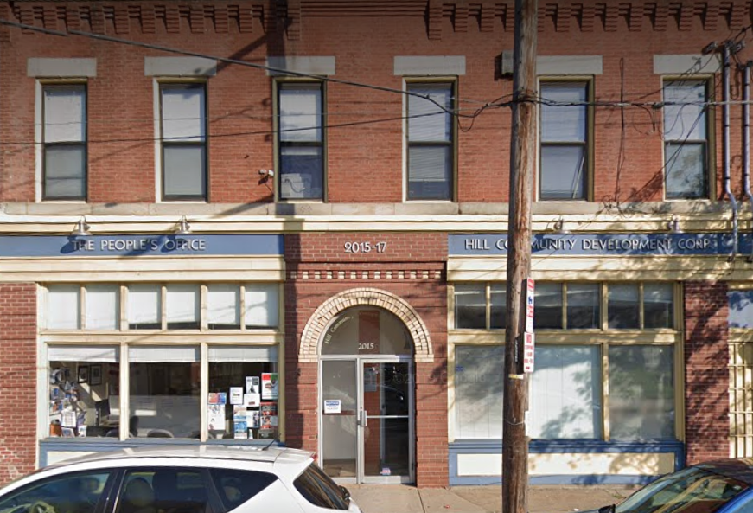
2015 Centre Avenue: Then vs Now
Now
1958
1972
Source: Google
Source: Teenie Harris Archives

Slide 4
Social Work Practice in Gov’t Setting
Micro
Constituent Needs
(ranged from faxes, phone calls, rent rebate, connect cards, etc.)
One on One meetings
Conflict Resolution
(landlord issues, financial barriers, etc.)
Mezzo
Team Meetings with Staff
Partner with organizations to plan community events
Attended neighborhood meetings
Macro
Promote Public Policy Change
**Maternal Health Policy Analysis Project**
Understand the impact of social determinants of social mobility
Understand systemic forms of oppression, and how it has impacted District 19 neighborhoods historically

Slide 5
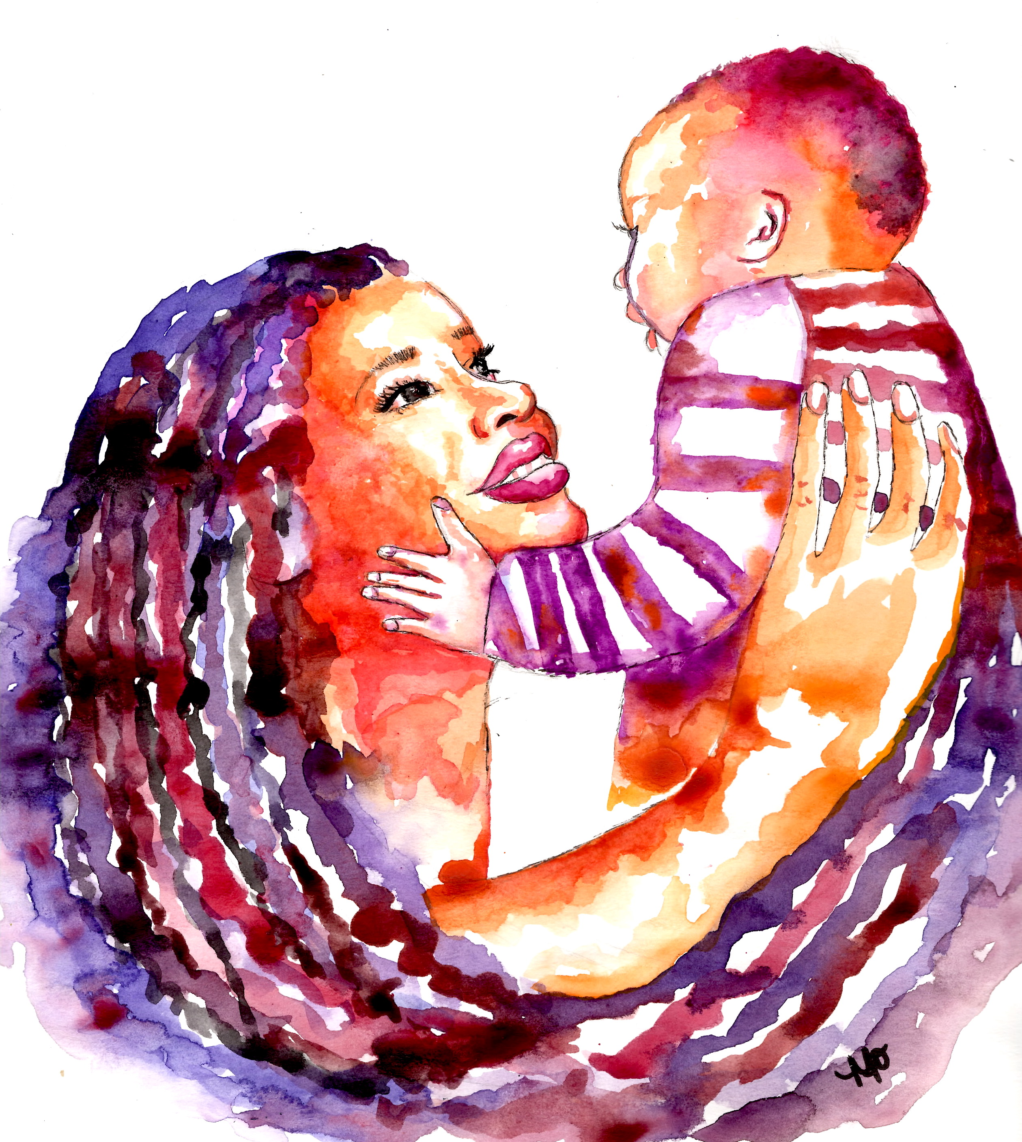
Maternal Health Disparities in Pittsburgh
A Policy Analysis Project

Slide 6
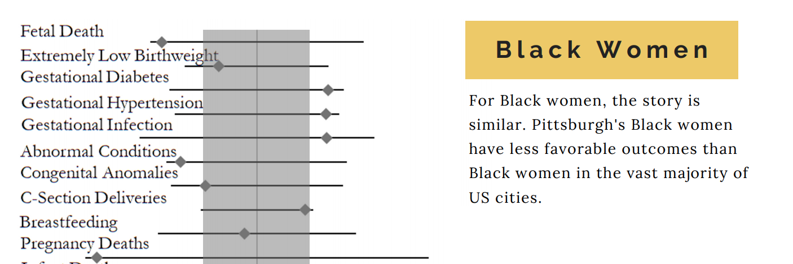
Background
Negative
Average
Positive
Source: Pittsburgh’s Inequalities Across Gender and Race (2019)
Notes:
The United States has the highest maternal death rate among developed nations
Black women are three-four times more likely to die – EVEN after accounting for socioeconomic status AND education

Slide 7
WHY?
Racist views of Black patients among medical professionals
Historical malpractice in medical field
Intersectionality of racism and sexism
Right to access of quality health care consistently under threat
Reduction of health services by legislators in government

Slide 8
What HAS been done?
2018 – Gov. Wolf enacted Act 24 - PA Maternal Mortality Review Committee
Reviews all maternal-related deaths, to develop strategies to reduce preventable morbidity, mortality and racial disparities
Local Organizations have been on the frontlines of services and preventative action:
Heathy Start, Allegheny County Health Department, Midwife Center, Women’s Law Project, UPMC Magee
Safer Childbirth Cities Initiative – Consortium of nonprofits to develop safer and more equitable ways Pittsburgh can leverage maternal and child health outcomes

Slide 9
Recommendations
Utilize policy and legislation as a tool to reset the standard of an intersectional maternal healthcare framework
Advocate for co-sponsorship of Rep. Meghan Cephas’ (D-Philadelphia) proposed bills:
H.B 2107 – Would add severe maternal morbidity to the list of reportable events within the Pennsylvania Department of Health.
H.B 2108 – Would extend Medicaid coverage for pregnancy related and postpartum medical assistance.
H.B 2109 – Would extend Medicaid coverage to doula services and create a Doula Advisory Board.
H.B 2110 – Would require training to address implicit bias and culture competency that impact care and quality of care for patients of color, including women of color during pregnancy and childbirth.
** Similar to Senator Kamala Harris’ Maternal Care Access and Reducing Emergencies (Maternal CARE) Act
Notes:
For Women of Color, 27.2 of 100,000 live births result in deaths that could be prevented
Worked with Harrisburg team to understand how to conduct policy analyses

Slide 10
THANK YOU

