Slide 1
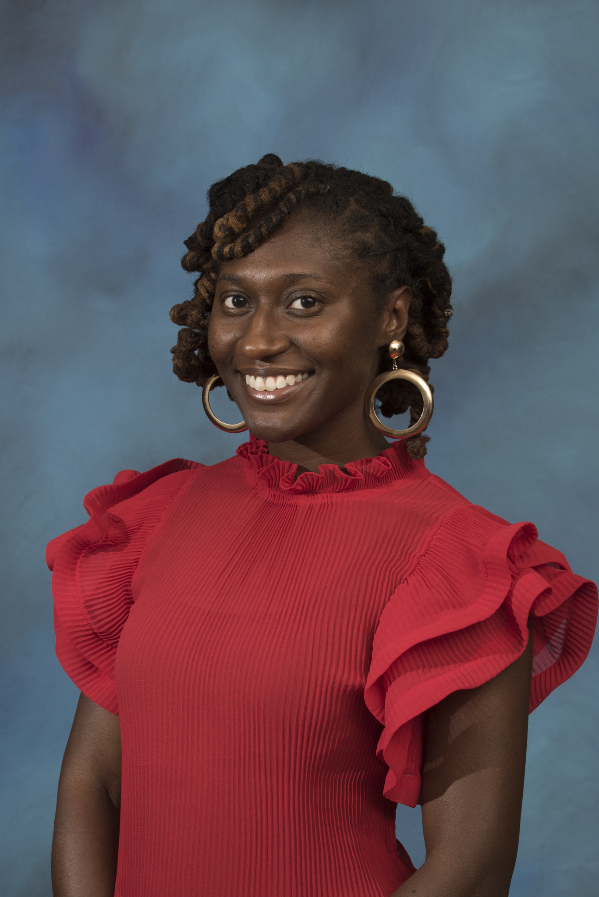
Daisia Williams, BSW, MSWc
MSW Intern- Office of Community and Governmental Relations

Slide 2
agenda
CGR History & Mission
Community Engagement Team & Services
My Placement Position
Community Engagement Takeaways

Slide 3
Community & Governmental Relations
Mission: "to develop and strengthen effective relationships between the University and federal, state and local governments, and community representative organizations in order to maximize support of University operations"

Slide 4
Website: cgr.pitt.edu
Pitt’s Neighborhood Commitments
Community Engagement Centers
CEC in Homewood
Hill District’s CEC
Commitment in Oakland
Be a Good Neighbor
Institutional Master Plan
Participation in Community meetings
Office of Community and Governmental Relations
Community
engagement
team & services

Slide 5
My placement position: communication of community engagement w/ cassandra hayt
Produce CGR Content
Participate in Inter-office meetings
Serve on planning committees
Research & Data Collection

Slide 6
My Placement Position: Communication of community engagement
Tools
Skills

Slide 7
Community Engagement Takeaways
Broad meaning of Community Engagement
Expansion of Community Engagement Professional areas
Use of Advisory Boards

Slide 8
Thank you!
Special thanks to Cassandra Hayt

