Slide 1
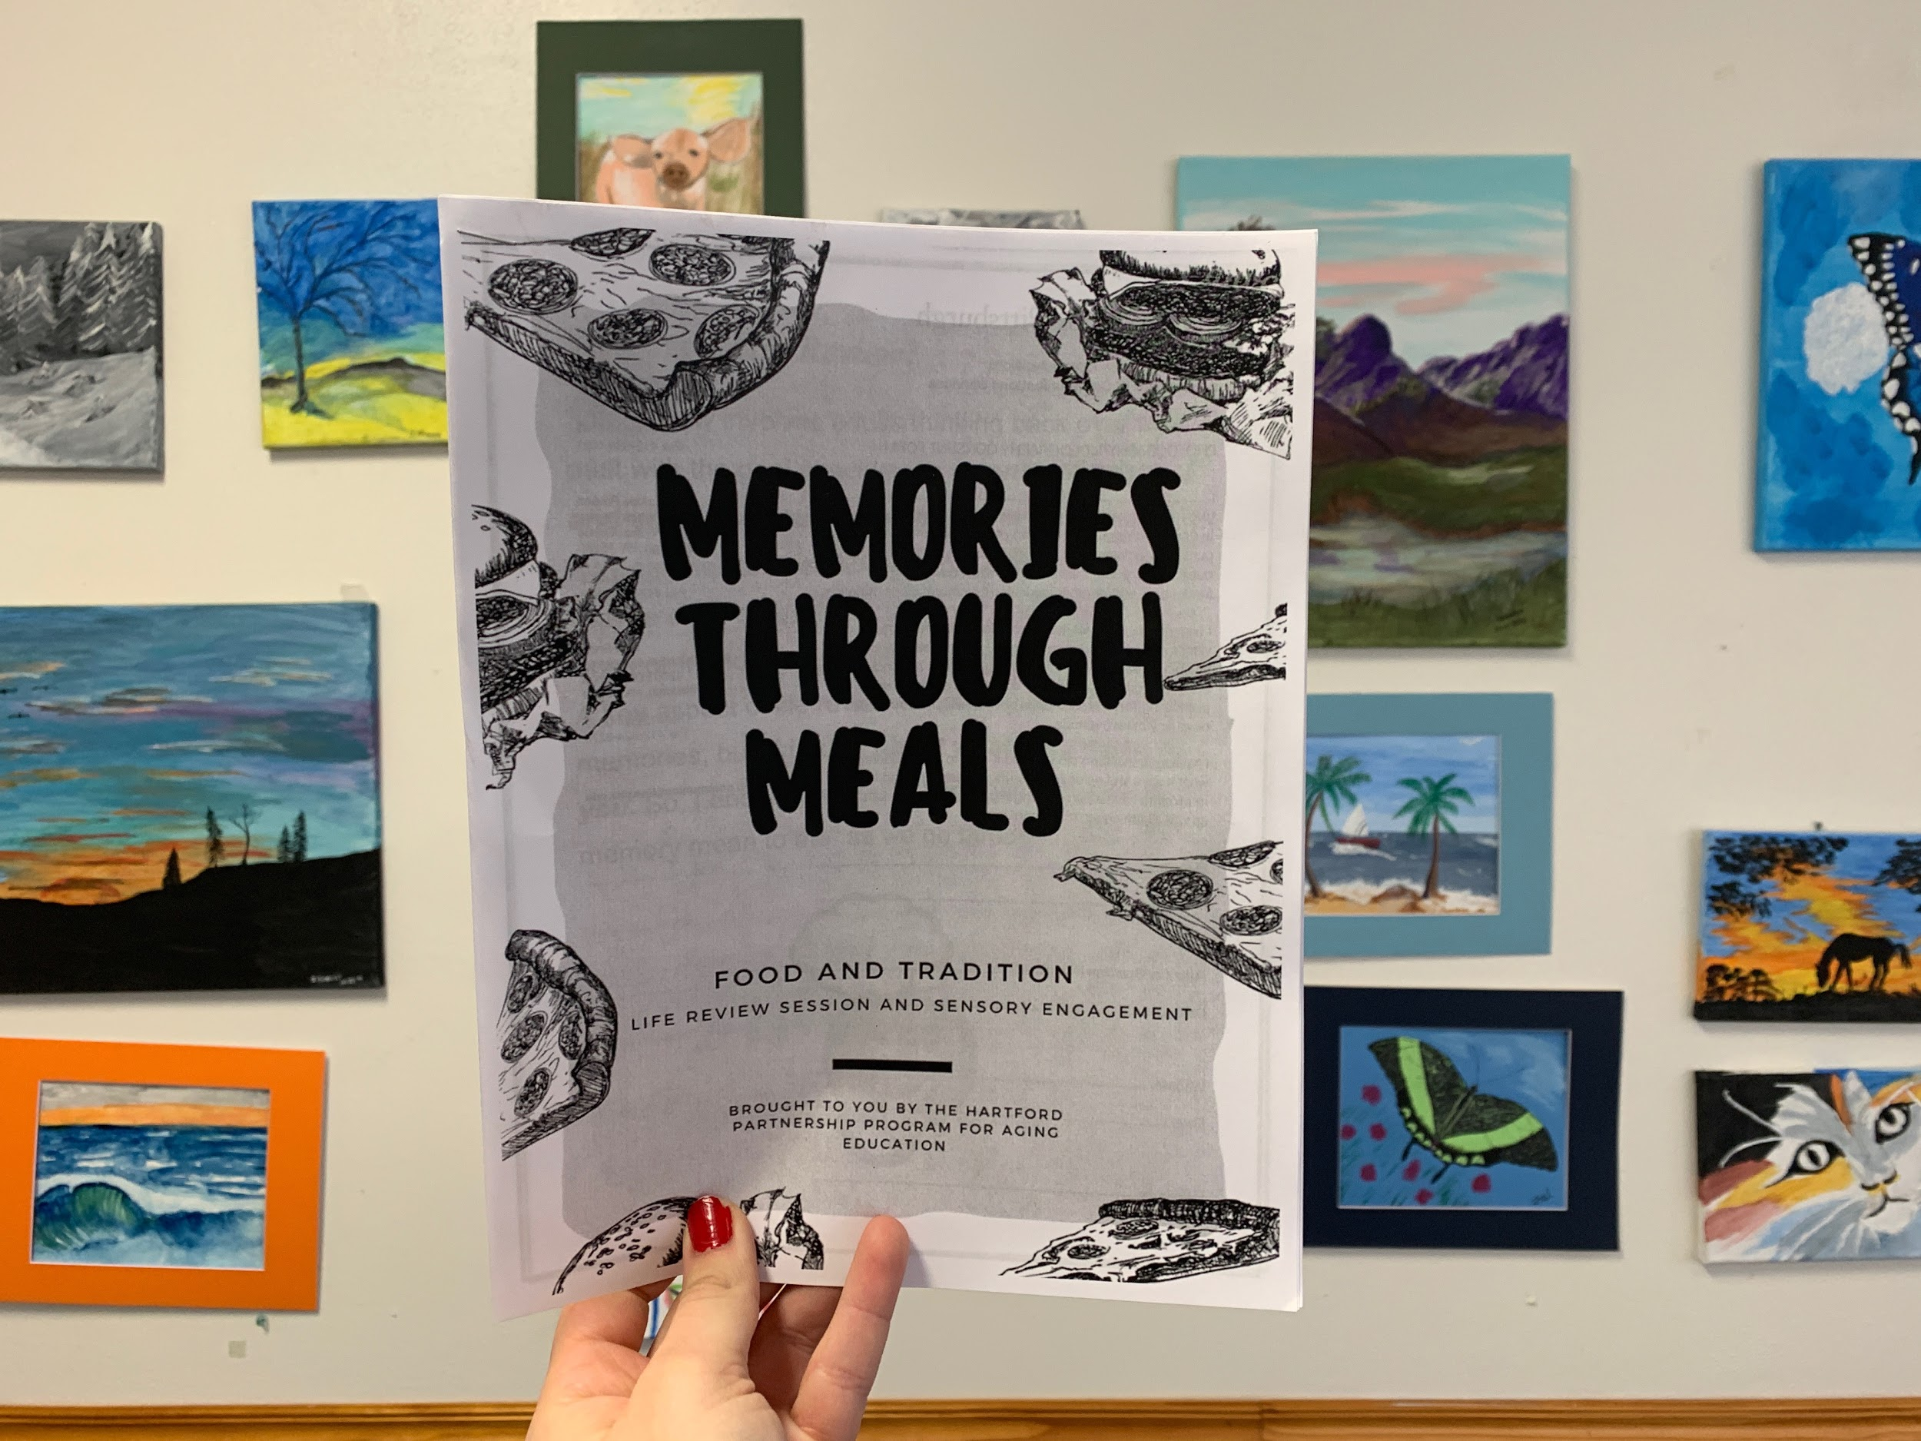
Memories Through Meals
Allen Collins
Emily Franke
Emily Svitek
Alisha Zanath

Slide 2
What is Life Review?
“Life review therapy is based on discussing what a memory means to you.”
The therapy can help with feelings about end-of-life issues and also help illuminate a greater meaning in life.
Notes:
To start we will review some of the concepts that inspired and guided our project. As the title suggests, memory is an important element to our project. We wanted to incorporate memory in a way that would have therapeutic and social benefits for older adults. This lead us to study life review which is a therapy that centers on discussing memories from across a persons life span and asking them, what do these memories mean to you. The goal is to actively and intentionally review one’s life, hopefully boosting acceptance, and allowing for validation. Life review is typically used with older adults because of research on it efficacy in use with people facing the end of their life. You might see this used in a palliative care setting for example. In addition to providing comfort at the end of life, life review can also help people find meaning in life events as they answer the question, What makes this meaningful.

Slide 3
What is Life Review?
The following populations may especially benefit from life review therapy
People with dementia or Alzheimer’s disease
Older adults suffering from depression or anxiety
Those diagnosed with a terminal condition
Those who have experienced the loss of a loved one
Notes:
As I mentioned, life review is frequently used and studied with older adults.
This isn’t just because they have more life to review, but also because of the unique benefits for certain sub-sections of the older adult population.
Specifically, research finds that those with a diagnosis of a dementia, depression or anxiety, a terminal illness, or those who have lost a close loved one find that the meaning making aspect of life review is a comforting activity.
Life review therapy can also promote improved self-esteem as people may not realize the significance of the things they have accomplished across their life span, from being the first person in their family to go to college, or raising children.
Looking back can help many people feel proud of what they have accomplished.

Slide 4
A Need for Life Review
Positive outlet for older adults
Therapeutic benefit outside of a therapy setting
Accessible to many settings for implementation
Accessible to wider array of older adults
Notes:
So why focus on life review? Life review provides a positive outlet for older adults, even if they do not carry a mental health diagnosis like depression, it is accessible to anyone.
Life review, unlike other therapies can be used outside of clinical settings and can be provided by non-clinical staff.
The flexibility of life review allows it to be adjusted for use in many settings without compromising on the integrity.
It can also be adapted to the cognitive needs of older adults, meeting them where they are at in terms of ability.
Overall, life review is a very flexible program that has a large evidence base for its effectiveness with a wide range of older adults.

Slide 5
Benefit of Life Review
Evidence that the recall of happy events stimulates the brain differently than recalling neutral memories:
“These results reinforce the notion that happiness induction engages a wide network of brain regions.”
… can have a positive short term effect on depression, psychological well-being, and loneliness (Chiang et al, 2009).
… can produce a feeling of accomplishment in participants, improve socialization, and reduce risk of developing depression (Chiang et al., 2009).
Notes:
Outside of emotional and social benefit research has been done on the neurological level, examining brain areas that are effected by memory recall.
Life review asks participants to think back on happy times in their life. Researchers looked at patterns of activity in the brain and found that happy memories make the brain light up. This recall of happy events stimulated brain regions differently than the act of recalling emotionally neutral memories, increasing activity across neurological networks
Happy memories engage a much wider range of brain regions, which can be especially positive for older adults as some may have a variety cognitive deficits.
Additionally, researchers have found that there is an immediate benefit to life review, those with depression can experience an immediate short-term relief from some symptoms, which makes life review different from other therapeutic modalities.
Life review lends its self well to populations that may be lacking social interaction. When used it can produce feelings of accomplishment, and if used in a group setting improve engagement.

Slide 6
How it has been used before…
Therapeutic settings with provider
With families and older adults
Reviewer controls the content
Structured or unstructuredd life review
Notes:
Life therapy can be done through a variety of methods and there is a lot of room for creativity both for the participant and presenter.
Life review has been used in 1:1 therapy, with a provider and a patient as a part of talk therapy.
It is also frequently used, either by name or informally by families and older adults. Most often there is a “reviewer”, the person who is conducting the life review, and they control the flow and focus of the review.
For families they may use worksheets, or questionnaires.
Finally, life review can be structured- starting from birth and earliest memories, or focused on a particular subset of memories, or it can be unstructured. Unstructured life review might be embedded in a larger conversation about values and is often used in conversations about goals of care at end of life.

Slide 7
Benefit of Sensory engagement
Sensory stimulation uses everyday objects to arouse one or more of the five senses (hearing, sight, smell, taste and touch), with the goal of evoking positive feelings.
Notes:
Sensory stimulation engages the 5 senses using everyday objects to help stimulate different brain regions. Research shows that sensory play in children helps builds nerve connections in the brain’s neurological pathways.
Sensory play supports language development, cognitive growth, fine and gross motor skills, problem solving skills, and social interaction. Similarly, sensory engagement has brain benefits for older adults in the same areas: fine and gross motor skills, problem solving, and social interaction.
Combining meaningful activity, like discussion of one’s life with sensory stimulation can enhance a persons’ overall sense of wellbeing. Art, gardening, cooking, are all activities that engage the senses in a way that can be meaningful and engaging for older adults.

Slide 8
Combining life review and Sensory Engagement
Notes:
There are numerous benefits to life review, however the largest barrier to using this is allowing for older adults to have access.
For an older adult, not involved in mental health care, palliative care, grief counseling, or another clinical setting their opportunity to experience life review is limited.
We therefore decided to tackle this issue of access by creating a life review program that could be adaptable to multiple settings, by a variety of professions to reach a wider range of older adults.
The novelty of this project is combining life review methods with sensory engagement in a way that makes this activity accessible to a variety of settings.
While gardening, and cooking are great activities they can be challenging and expensive to implement.
We set the goal of combining these two well researched areas in a format that could be implemented at a low cost in a wide variety of settings.

Slide 9
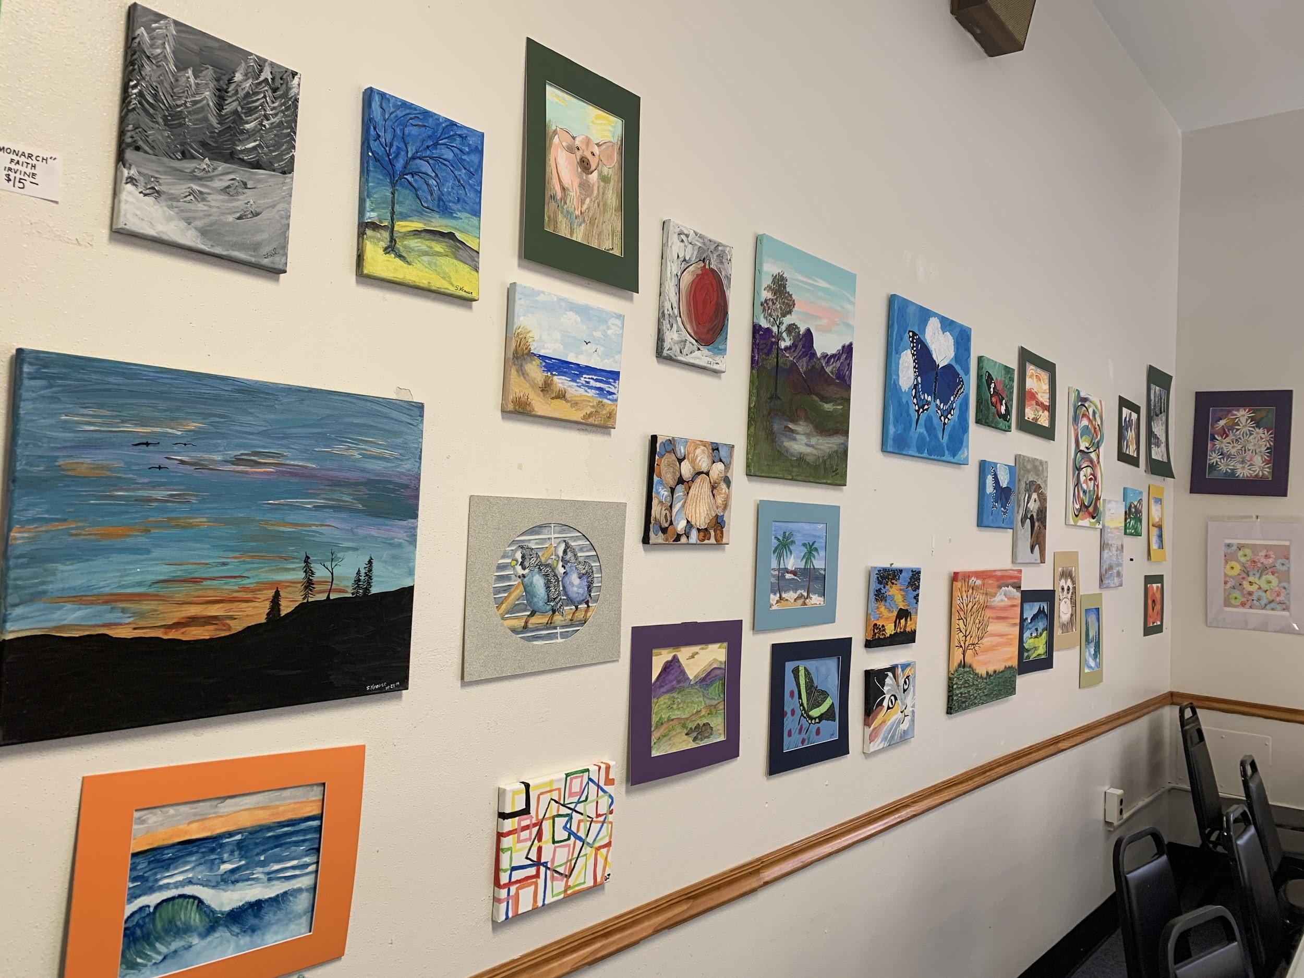
Goals
Allow older adults to connect with one another on the topics of food, traditions, and memories
Evoke memories and traditions through a life semi-structured review
Assist participants in creating a ‘memory tree’ that can be taken home and discussed with family/friends
Notes:
As discussed in previous slides by my colleague, Emily, life review has numerous benefits for older adults. Just to recap, life review can act as a positive, creative outlet for older adults. It is incredibly accessible and can be performed in really any setting. Also, research points to its many benefits, some of which are reducing the risk of developing depression and the increase of socialization amongst older adults.
So, based off these benefits, we wanted to focus our project on forming a life review that could be low maintenance (making it easy to replicate/repeat in a variety of settings) and that would allow for socialization and connection with other older adults on a neutral, universal topics: food, traditions, and memories. We decided to select these topics based of the benefits of sensory engagement, and due to Pittsburgh diversity and emphasis on family, tradition, and culture. Through this life review, we wanted to evoke memories via scents and sounds. Once these memories were evoked through our semi-structured review, we wanted our participants to create a memory map or memory tree, where they could illustrate these memories. Our intended purpose of this creative project was for it to act as a meditative or therapeutic mechanism. We hoped that when the participant looked at this creation, they were reminded of the memories discussed during the life review. We also hoped it would be used as a conversation starter between friends and family-almost leading to a mini life review at home.

Slide 10
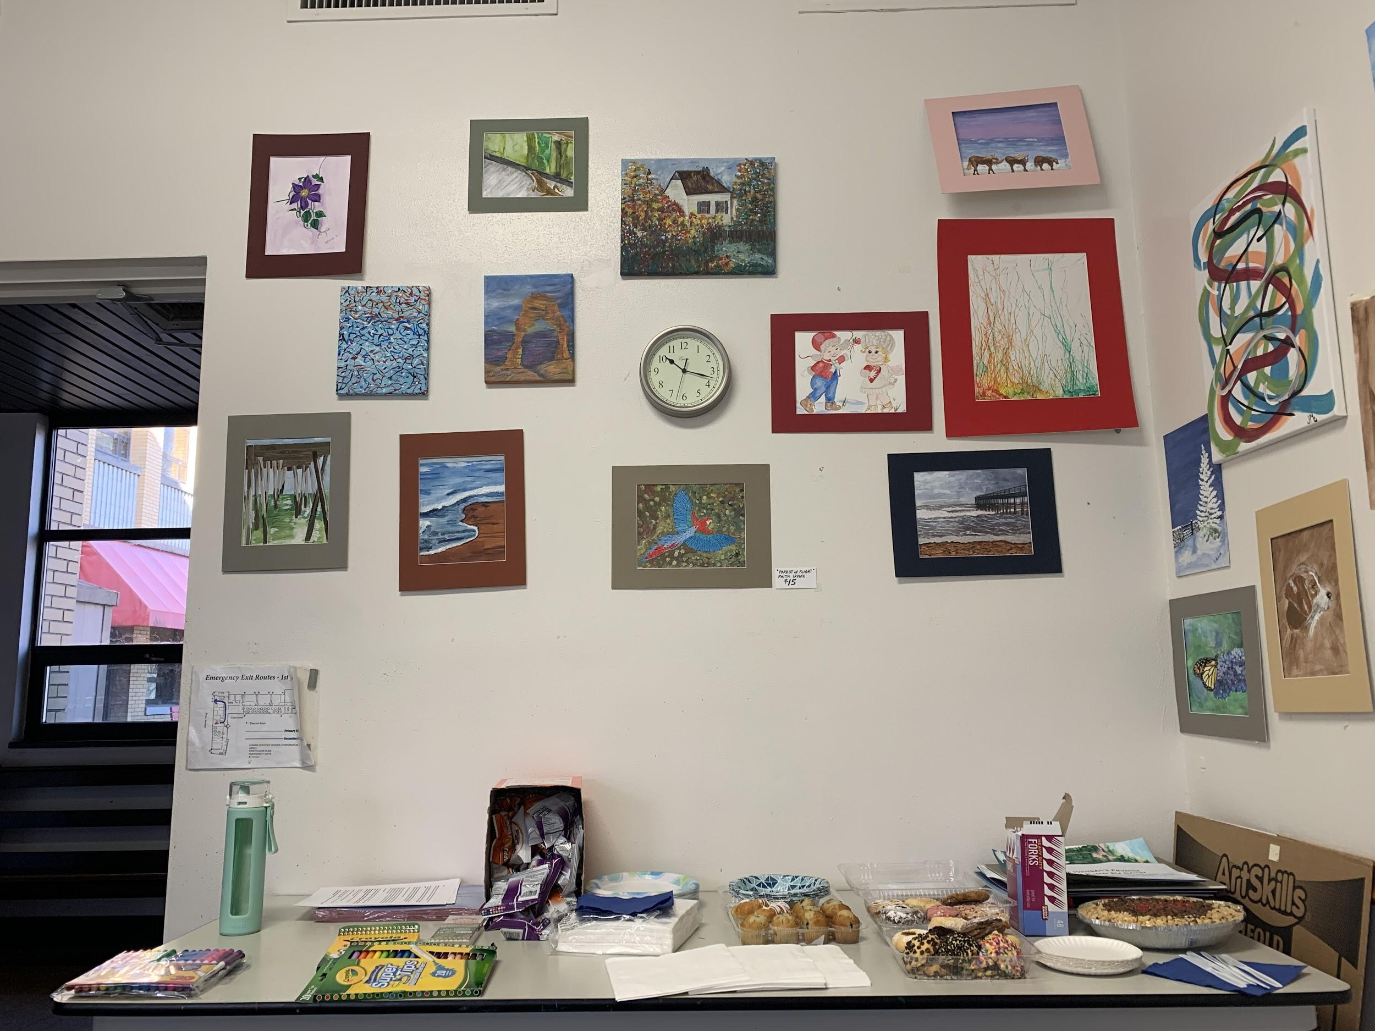
Project Overview
2 part seminar at a local community center
Part 1: Introduction and discussion of life review
Part 2: Life review and creation project
Emphasis on themes of food, tradition, and family togetherness
Setting: Turtle Creek Senior Center
Participants: Older adults from the Senior Center’s Art program
Notes:
Selection of a community rooted space: We were thinking of trying to conduct our seminars in an inpatient setting; however, we decided against it for 2 reasons. The first for logistical and privacy reasons- we did not think we would be able to breach the restrictions (understandable so) that inpatient units held. The second being we wanted to interact with community members in a familiar setting, where they felt comfortable to discuss intimate moments and memories of their life. Conducting this project right off the bat in an inpatient setting, we felt, would hinder the vulnerability and emotion we were trying to elicit from participants. We were lucky enough to be connected to Turtle Creek Senior Center by one of the other Hartford Fellows. This senior center, in particular, had a robust art program already in place and was willing to allow us to run our life reviews in 2 one and a half our sessions, over the course of 2 weeks. The first session, we explained what life review was and handed out a workbook, where we gave time and space for participants to right down memories over the course of their life- memories were elicited from questions we asked, based upon the conversation. Session 2 was hosted a week, and it was when we conducted the actual life review. We brought in essential oils and spices (rosemary, cumin, cinnamon) to share with the group. Once the group observed the sound or scent, we used probing questions to try to elicit memories from the scents and smells. Sometimes the conversation did not necessarily go exactly where we intended (Allen will speak more to that), but regardless of where the conversation went, numerous particpants jumped in to add memories.

Slide 11
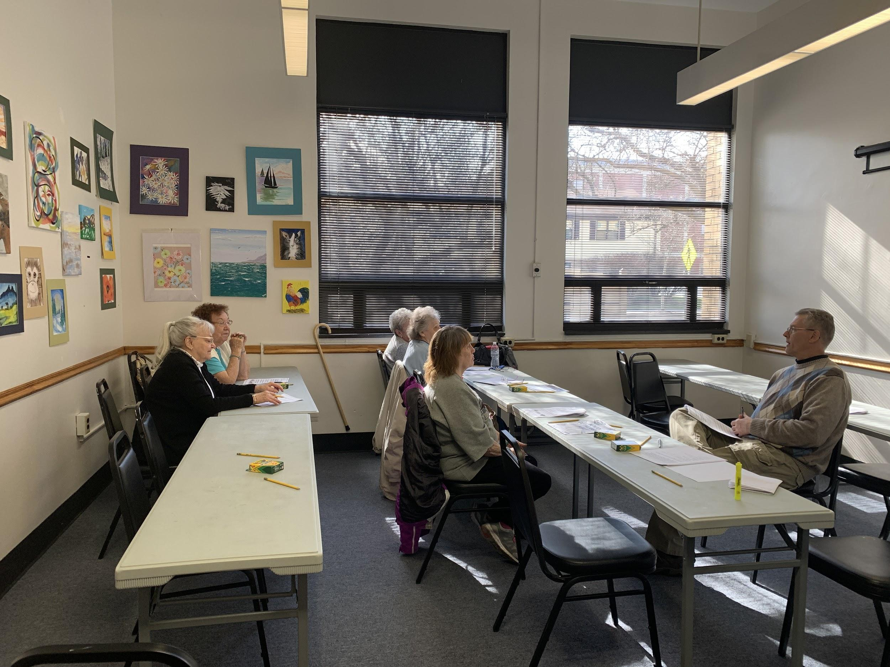
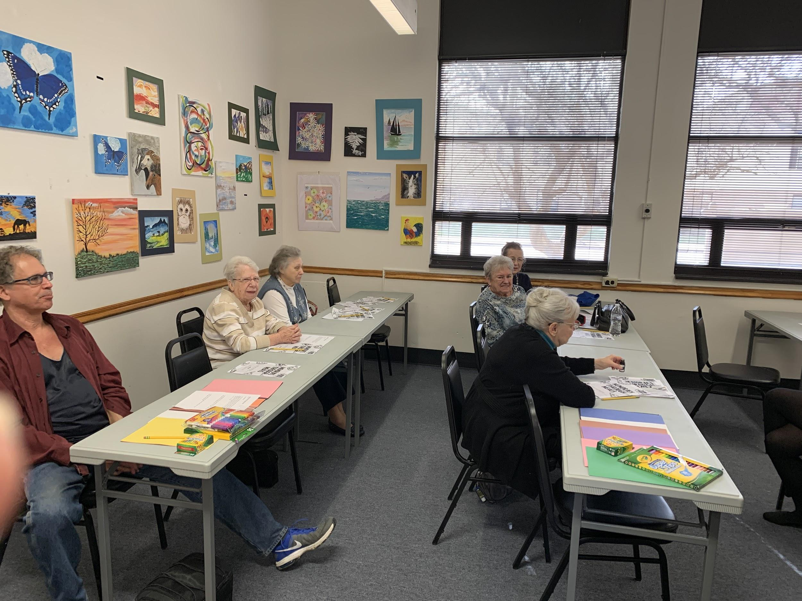
Seminars
SEMINAR 1
SEMINAR 2
Notes:
So, these are two photos from the seminars we held. The first seminar is pictured. We had five participants, all of whom were from the art class. Emily and Allen had previously gone ( a week earlier) to advertise our life review to the art class. The art class seemed very interested, but they requested snacks- and much more than the goldfish we were originally planning. The second seminar, we had more people and we had our first gentleman! Some of the participants in the second session were new to the seminars. But, we had designed our seminars in a way that it was not a necessary factor to attend the first one, in order to come to the second one. And you can see on the walls all the artwork- these are pictures that some of our particpants created themselves, of which they were very proud of.

Slide 12
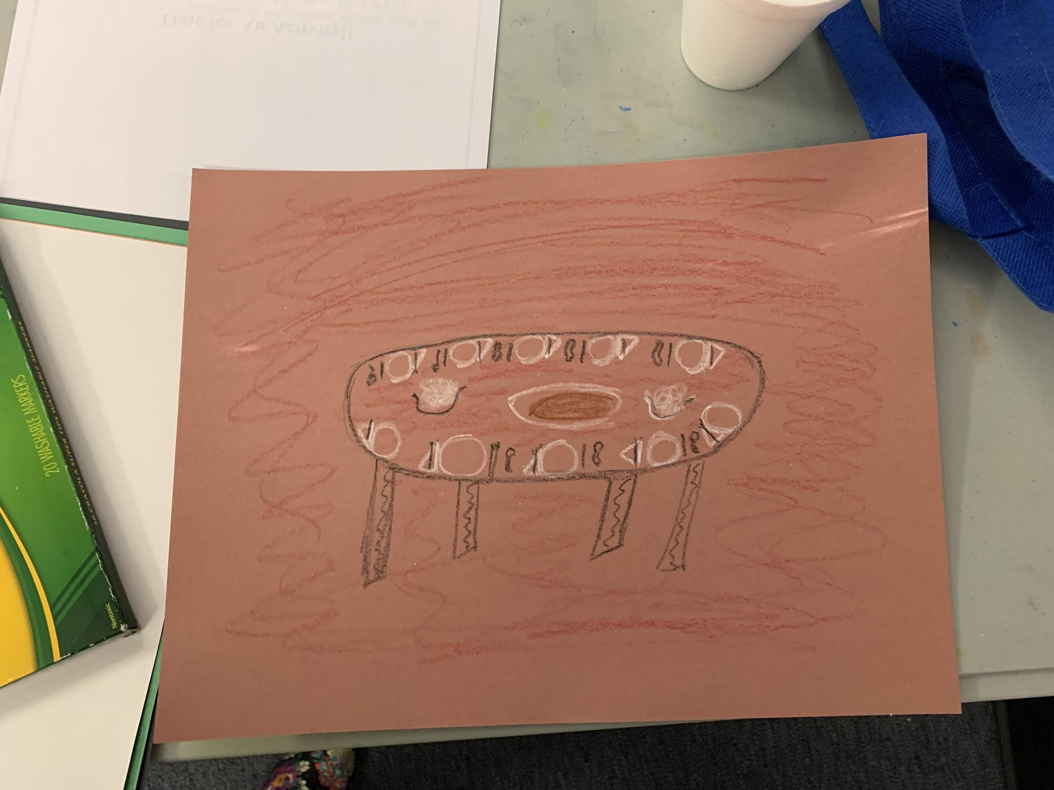
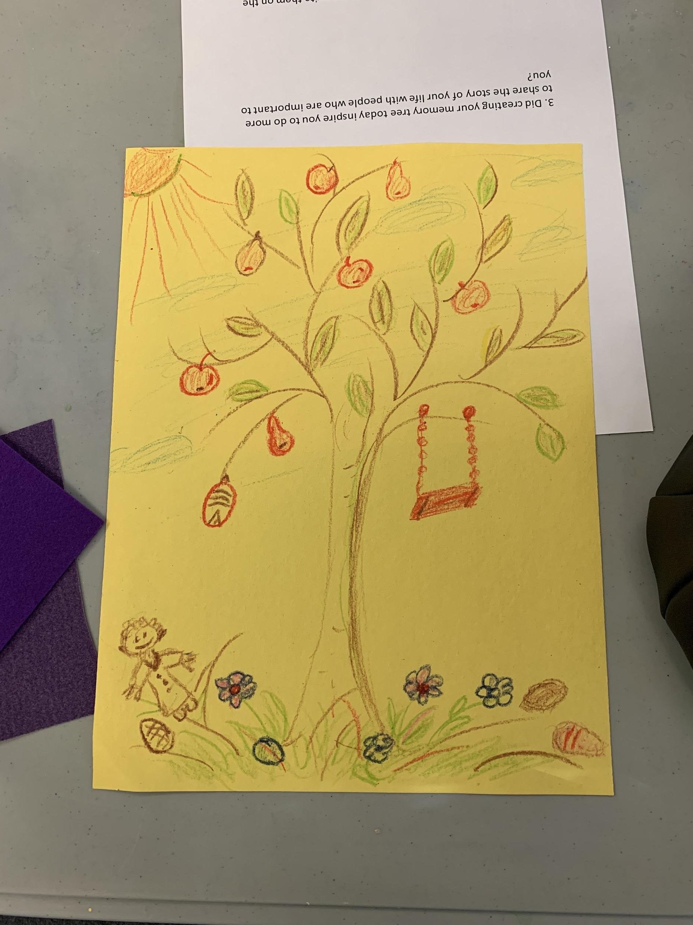
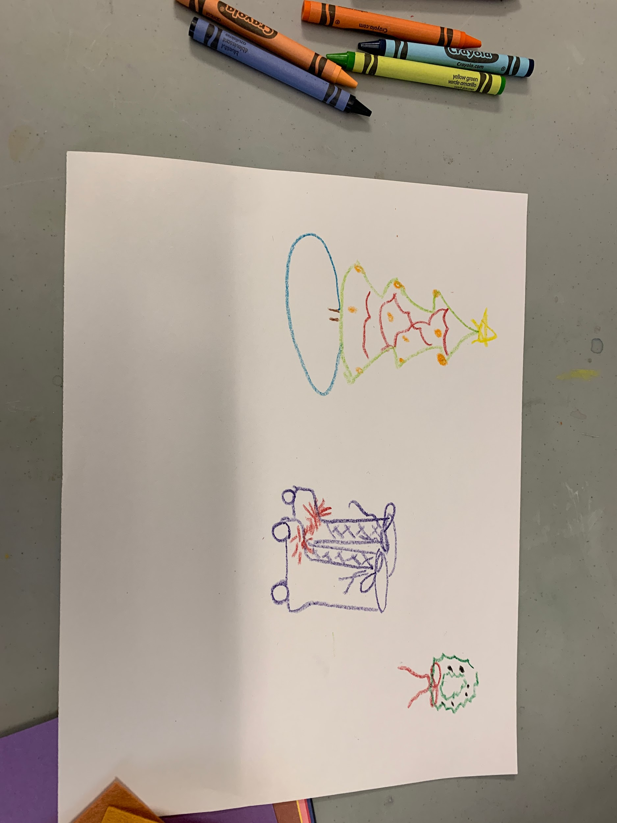
End Products
Notes:
So these are the end products- the memory trees and memory maps the participants made after the life review in the second session. These pictures were photographed with the participants’ permission, as it is their own personal work. Starting with the first picture, on yellow construction paper- this was a depiction of one of the participant’s childhood memories. She had a fruit tree in her backyard, which she would pick fruit from for pies and other recipies. She also talked about the swing on the tree, which she and her siblings would play during the summer. Moving to the next picture- the one on the top right hand side on brown construction paper- this was one of our participant's memories of a holiday meal. I believe this participant came from a large Italian (or maybe it was Eastern European) fgmily. She talked a lot of about the large family meals her family would have around the holidays. Specifically, she talked a lot about the scents surrounding the meals and roasts her family would make. Below that, on the white construction paper, is an image from one of our other participants. She talked about Christmas, specifically her first pair of roller-skates she received as a child. We then had a lengthy discussion about her passion for roller-skating.

Slide 13
What Happened
Vibrant roundtable discussions
No Powerpoint capability meant:
No visuals to influence participant thoughts
Allowed participants more control over the conversation

Slide 14
What Happened
Expected: happy shared memories surrounding food
Homemade sauerkraut
Big Italian family meals
Unexpected: food memories surrounding more serious times
During WWII
Powdered pudding
Sugar rationing
“Mud” soup - lentils cooked till they dissolved
Tomatoes drying in the sun – collecting flies

Slide 15
What Happened
General reminiscence were as important as those surrounding food
The memories of little girls during WWII
WWII service banners with gold stars hanging in windows
Worrying about uncles and neighborhood men who were off to war
Baby dolls
Working at the drugstore soda fountain as teenagers in a vibrant Turtle Creek community
Party lines
Funerals

Slide 16
What Happened
No matter how serious the memory, all were remembered fondly

Slide 17
What was important
Having the opportunity to share memories with others
The conversations and sharing in the moment was more important than capturing memories for loved ones
The affirmation that each individual life story was important
The pure personal joy brought on by memories

Slide 18
Was passing story on to family important?
Grudgingly – maybe?
Not all agreed that anyone cared
Some had no desire to share memories/life story with family
This did not reduce the enjoyment they drew from the sessions

Slide 19
Were project goals met?
Allow older adults to connect with one another on the topics of food, traditions, and memories
Absolutely
Evoke memories and traditions through a life semi-structured review
While discussion often strayed away from food the connection between participants based on reminiscence was profound

Slide 20
Were project goals met?
3. Assist participants in creating a ‘memory tree’ that can be taken home and discussed with family/friends
Memory trees were created by most however the idea of sharing them with family received a tepid response

Slide 21
What did participants say?
Verbal surveys at end of each session brought these responses:
Participants would like to have opportunity to do this more often
Expression of sincere gratitude for the time, space and companions to share their lives
Reminiscence has great value purely as a personal act

Slide 22
Participants were asked:
Does reminiscing, and thinking about wonderful times long ago, make you feel young, or does it make you feel old?

Slide 23
The answer (agreed with by all):
“Neither, it just makes me feel happy!”

Slide 24
What We Learned: Successes and Room for Improvement
Those that attended both classes stated that they had been looking forward to the second course.
Throughout the discussion, participants would visibly light up when discussing memories related to food.
As some participants shared their specific memories, others chimed in with their personal experiences of similar situations.
Participants had trouble identifying spices and smells, may be best to omit this in the future.
Would give more time for advertisement.

Slide 25
Suggestions for the Future
Memories Through Meals would be a great weekly or monthly activity, as participants enjoyed coming to both sessions and voiced a desire for more sessions.
Expanded setting where actual cooking could take place
Possible locations are assisted living and personal care homes.
Kitchens of senior centers
In a limited resource setting, simply talking about food memories is enough to bring participant satisfaction.
This works in settings like hospice or in working with participants of limited mobility.

Slide 26
Implications for Social Work Practice
Service: Creating memories through meals programs are a great way to serve the aging community and allow a space for reminiscence and socialization.
Dignity and Worth of the Person: Asking participants to think about their life helps them realize that their past was meaningful.
Reminiscence: A great way to build rapport with new participants in variety of settings
Can help a wide variety of people find peace and meaning in their lives with stressful times.

Slide 27
Thank You!
Our project could not have been accomplished without the help of:
Turtle Creek Senior Center
Turtle Creek participants
Hartford Fellowship Mentorship and Support

Slide 28
References
Black, C. (n.d.). Retrieved from https://www.nacc.org/docs/conference/2010materials/Structure Life Review by Carla Black.pdf
Cerqueira, C., Almeida, J., Gorenstein, C., Gentil, V., Leite, C., Sato, J., … Busatto, G. (2008). Engagement of multifocal neural circuits during recall of autobiographical happy events. Brazilian Journal of Medical and Biological Research, 41(12), 1076–1085. doi: 10.1590/s0100-879x2008001200006
Chiang, K., Chu, H., Chang, H., Chung, M., Chen, C., Chiou, H., & Chou, K. (2010). The effects of reminiscence therapy on psychological well‐being, depression, and loneliness among the institutionalized aged. International Journal of Geriatric Psychiatry, 25(4), 380-388. doi:10.1002/gps.2350
Educational Playcare. (2016, October 20). Why Sensory Play is Important for Development. Retrieved from https://www.educationalplaycare.com/blog/sensory-play-important-development/
Haber, D. (2006). Life Review: Implementation, Theory, Research, and Therapy. The International Journal of Aging and Human Development, 63(2), 153–171. doi: 10.2190/da9g-rhk5-n9jp-t6cc
Nall, R. (n.d.). Life Review Therapy . Retrieved from https://www.healthline.com/health/life-review-therapy#life-review-therapy-benefits

