Slide 1
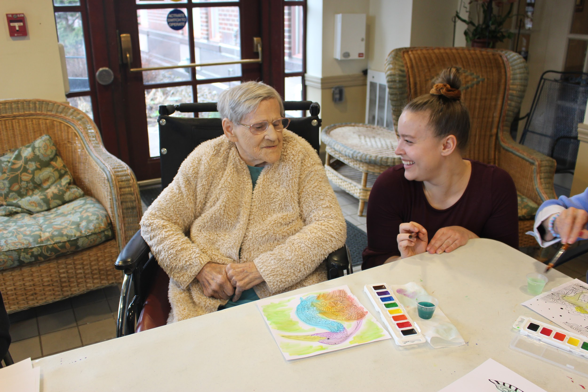
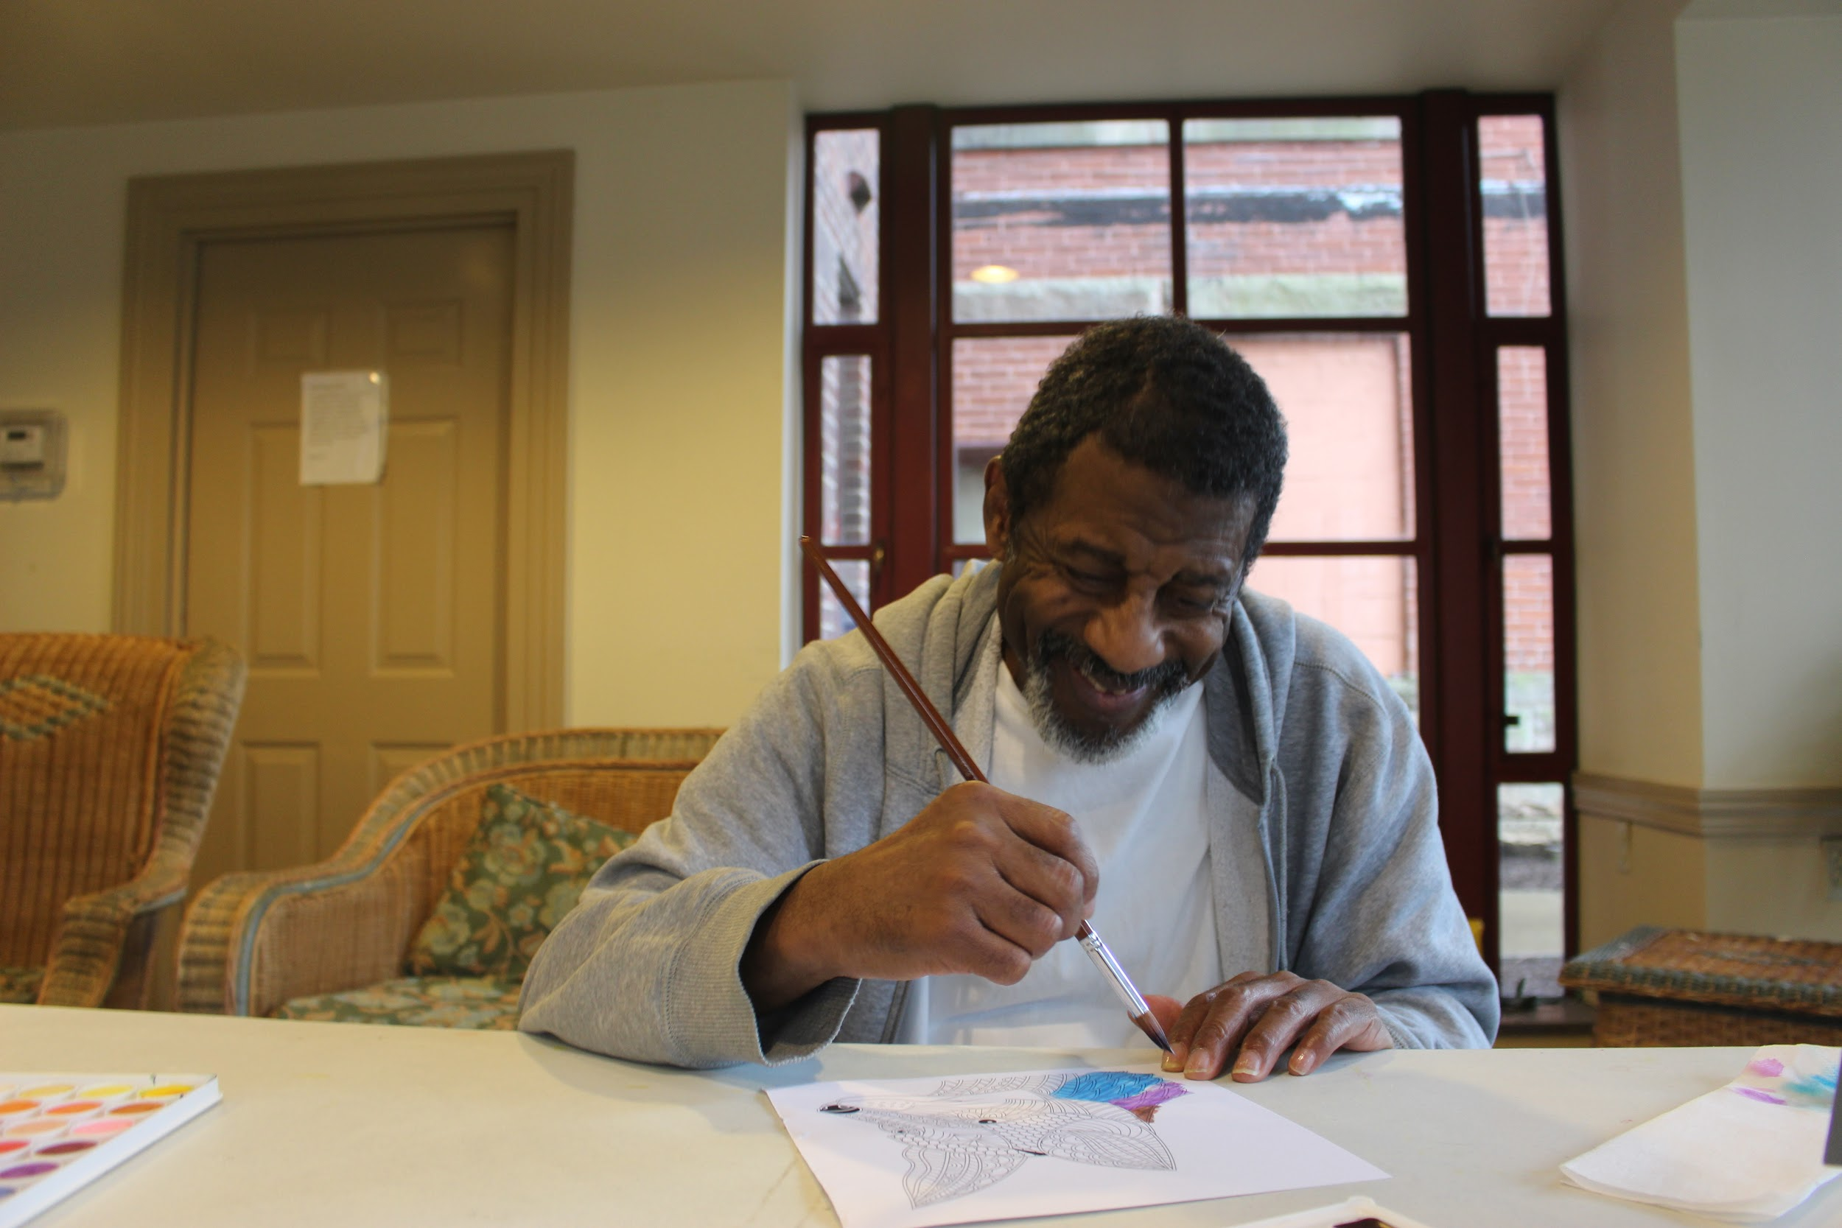
Dementia & Art Therapy
Colleen Hutzel, Michelle Andersen,
Marta Karczewski, and Kim Johnston

Slide 2
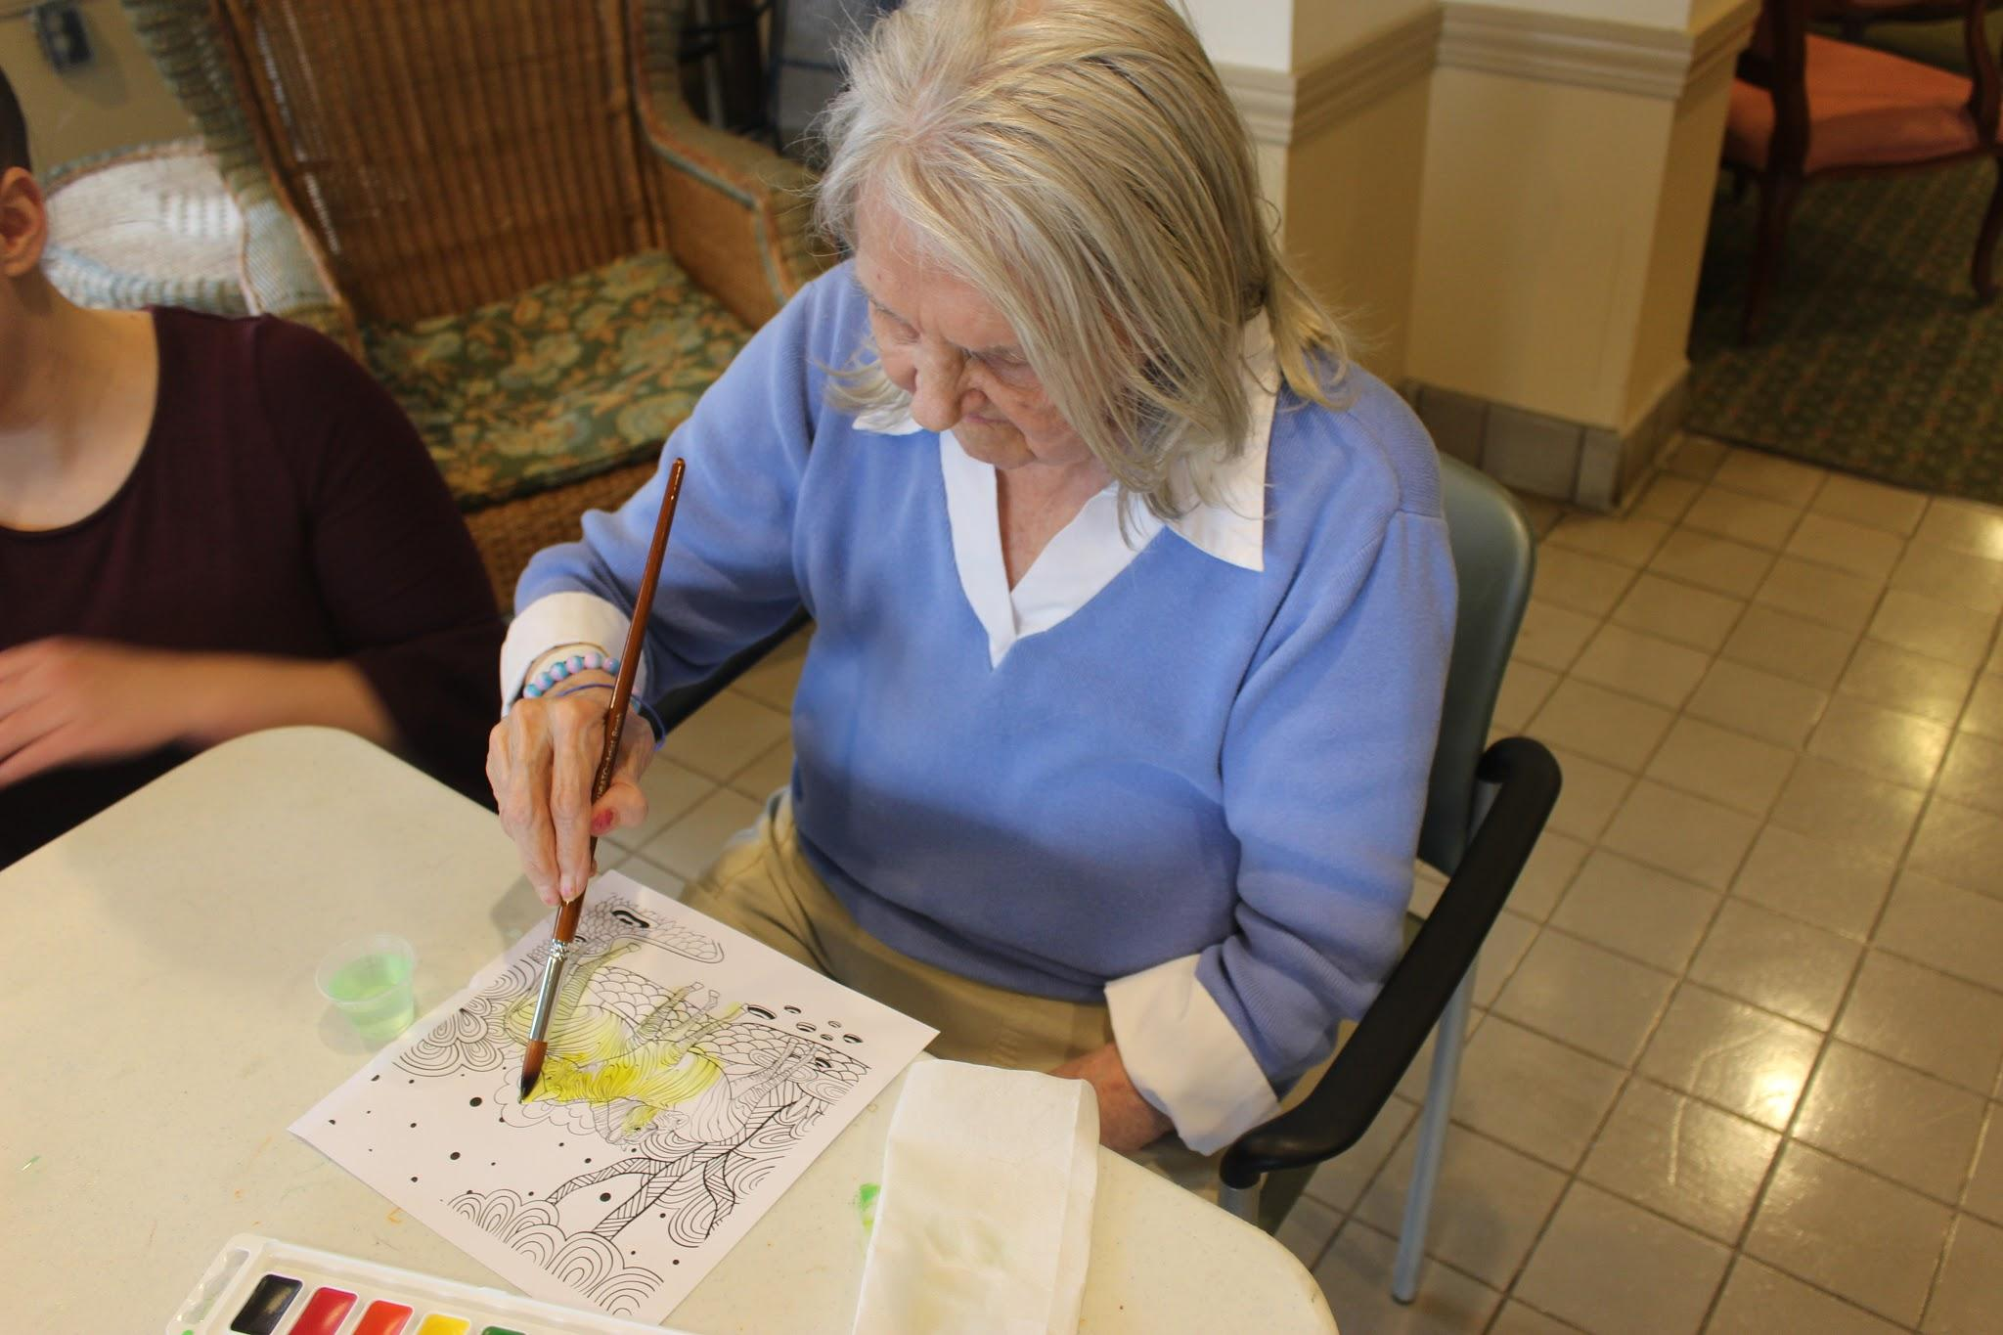
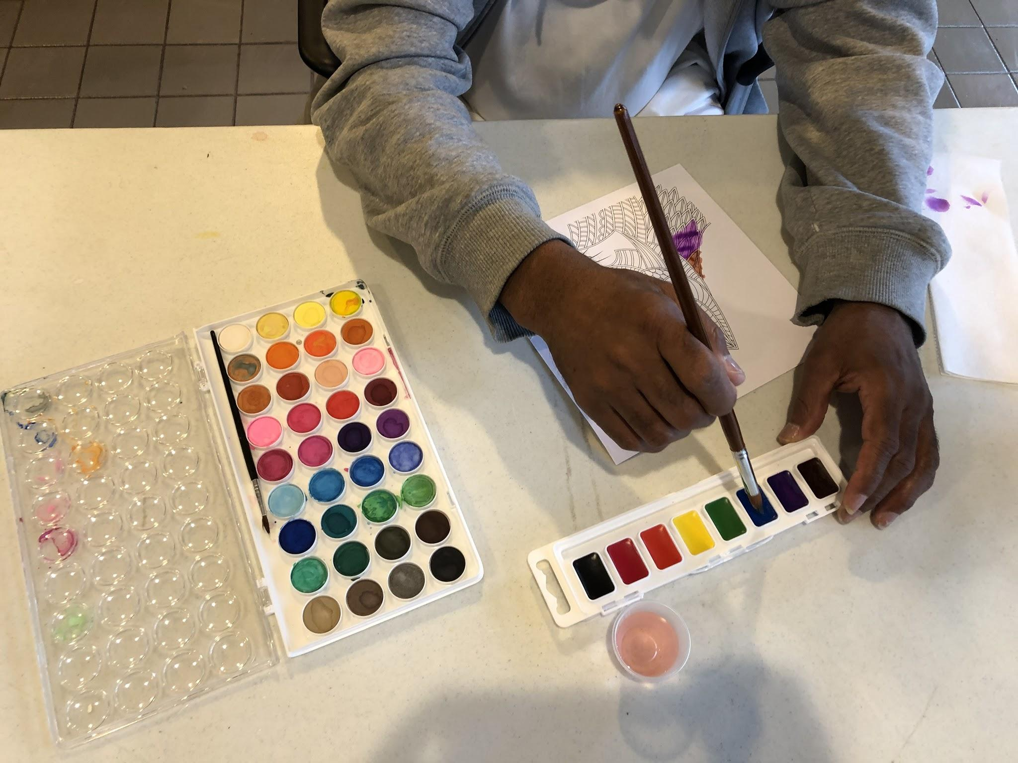
Project Overview

Slide 3
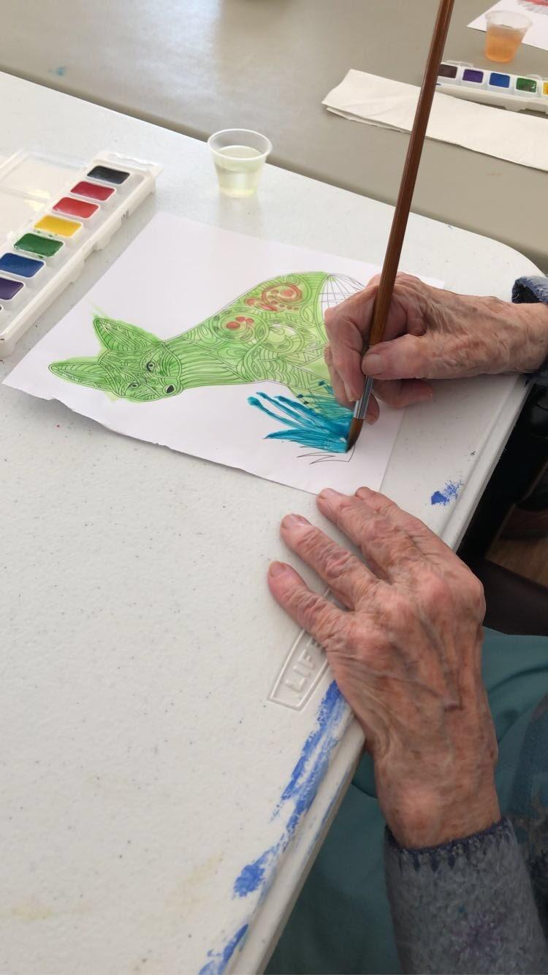
Creativity’s Impact on Dementia: Research
Dementia destroys brain cells, interfering with memory, thinking, and behavior.
Creating and viewing art allows those with dementia to express themselves in ways other than language.
Even those who have displayed no interest in creating art in the past may find an outlet for expression with help from trained facilitators.
Art can help brain plasticity, and challenging activities such as art can help form new synapses
Chance for shared experience and socialization
Notes:
The need, our research, cite journal articles
Dementia is a group of diseases, including Alzheimer’s Disease, vascular dementia, lewy body dementia, and frontal temporal dementia. The diseases affect each individual differently and is a progressive disease process. Some possible symptoms include memory loss, problems with language, disorientation to time and place, and decreased judgement.
Dementia destroys brain cells, interfering with memory, thinking, and behavior.
Creating and viewing art allows those with dementia to express themselves in ways other than language.
Even those who have displayed no interest in creating art in the past may find an outlet for expression with help from trained facilitators.
Research has found that creating art increases a sense of control, body movement, social engagement, and brain plasticity (Cohen)
Art provides a way for people with dementia to express themselves & communicate
Residents in nursing homes spend 90% of their time spent idle (Dan Cohen, Music & Memory)
Art can help brain plasticity, and challenging activities such as art can help form new synapses
Also a chance for socialization and shared experience.
Bruce L. Miller, M.D., professor of neurology and director of the Memory and Aging Center at the University of California, San Francisco
Cohen Article -site class 11, control mechanism, helps social engagement, “if not now, then when?”, meaning if you won’t do something now, when will you? It is beneficial to do what you enjoy and challenge yourself
Talk about Alma’s story!!! Alma kept stating she was not good at art and needed a lot of encouragement, and once encouraged, really enjoyed her time and had fun.

Slide 4
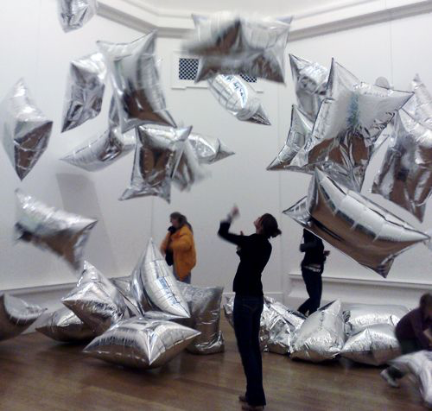
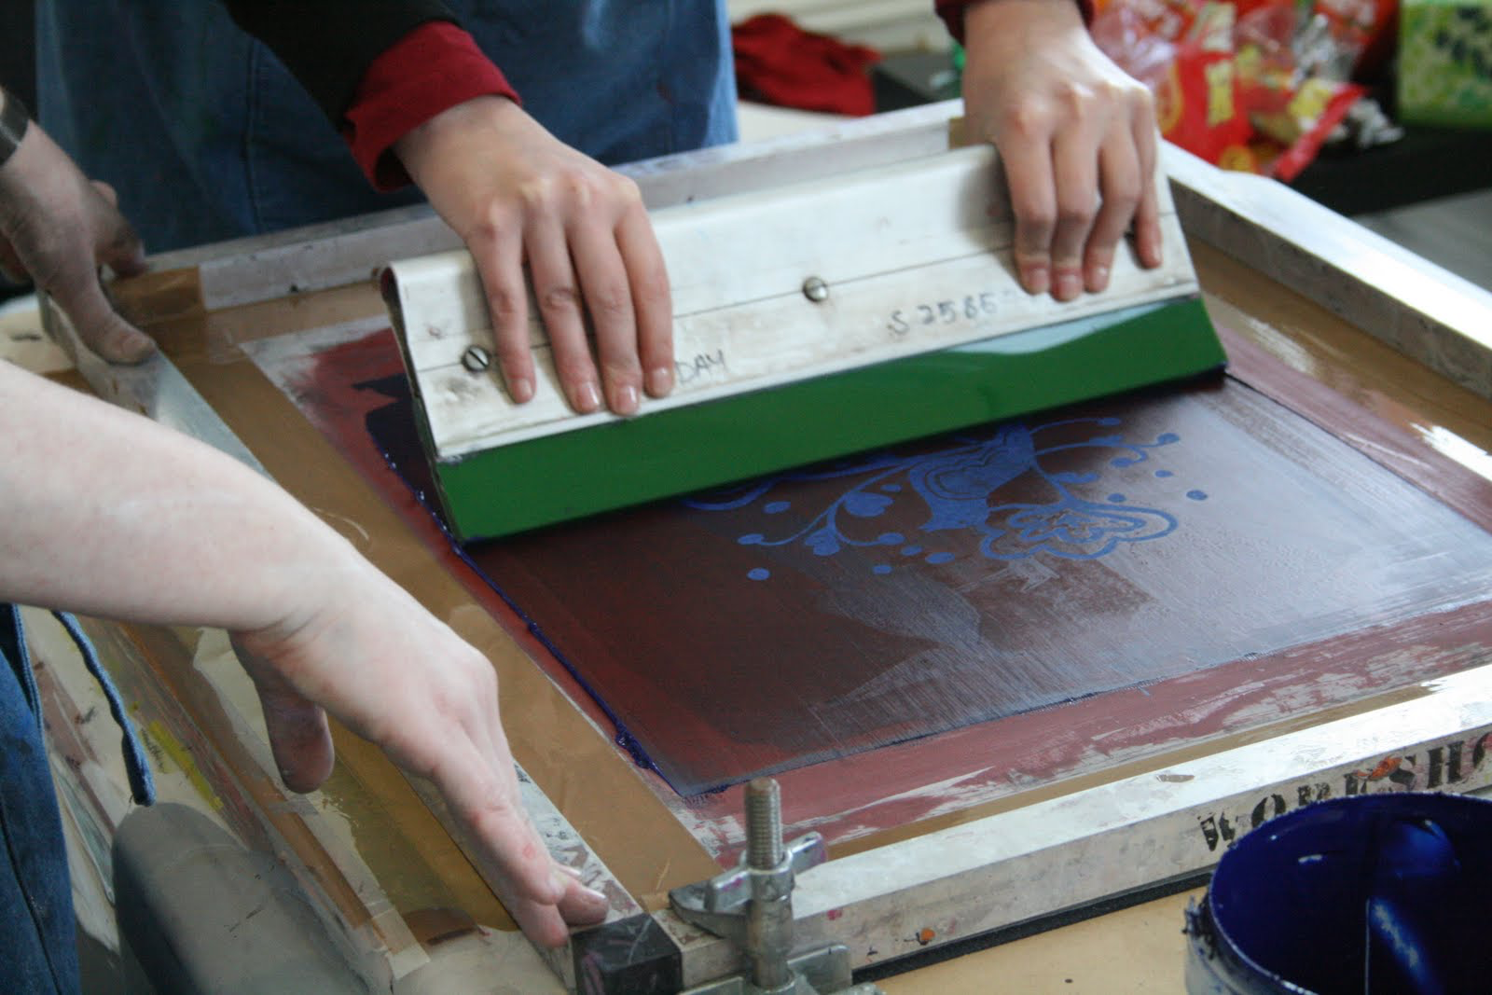
Creativity’s Impact on Dementia: Field Research
Notes:
We were inspired by the Museum of Modern Art (MoMA) in New York, the Carnegie Museum, and Andy Warhol museums’ art therapy program tailored for people with dementia.
The MoMA originally created the Meet me at the MoMA Alzheimer’s Project to help people with dementia to remain involved in community and engage in activities that are educational and enjoyable with an emphasis on the relationship with their caregivers. The program involved tailored discussions in the galleries as well as thoughts and reflections from participants and staff.
The Carnegie museum is similar to the MoMA’s set-up with time spent in the museum discussing paintings. Our group was really inspired by the twist the Andy Warhol put on the program with a more interactive approach.
In December, we went to the Andy Warhol museum to observe and participate in their Dementia Art Therapy Program. They were our main inspiration for utilizing a program like this in the community. They provided us with guidance and advice such as having a structured art piece instead of a blank piece of paper, which can be overwhelming. Their program makes a point to engage the participants’ 5 senses. Additionally, they taught us about engaging the participants with questions tailored to each art piece of art.
The day included painting watercolor pictures, a guided tour of the museum, singing Christmas carols, and silk screen printing t-shirts.
Silver Cloud Room - “How do the silver clouds make you feel?” “Would a silver cloud make a good gift?” (movement)
Silk screening- This was a tactile experience for the participants who with the help of a Warhol museum employee were able to smooth paint over a silk screen to create a Warhol inspired picture on a t-shirt
Through this experience, we saw the powerful effects of art therapy firsthand and started to structure our own version of the program to use in community nursing homes.
By looking at the programs used at the museums, we were able to identify gaps such as reaching people in the community and in their homes as a recreatable program.
We wanted to utilize this program in the community as well since not many people were able to use the program due to cost, ease of access, not every resident can travel to the museum, and can be difficult to spend a whole day in a different environment. We have all seen the effects of people with dementia being unengaged in their nursing home, which can lead to agitation and even behaviors.

Slide 5
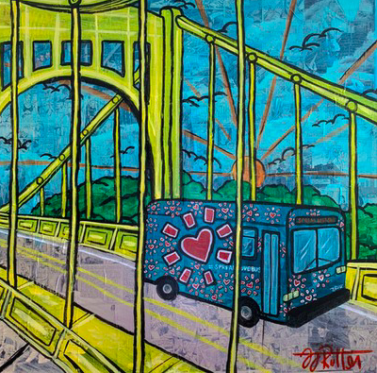
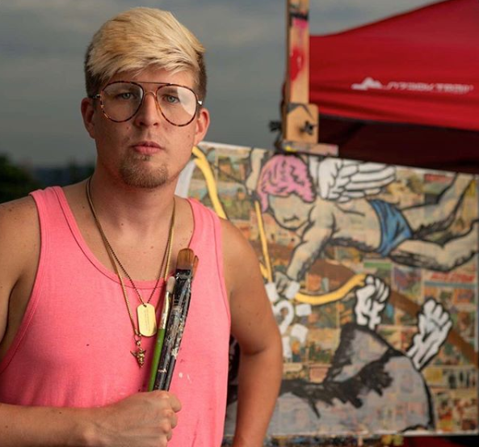
Zachary Rutter and “Spread Love Bus”

Slide 6
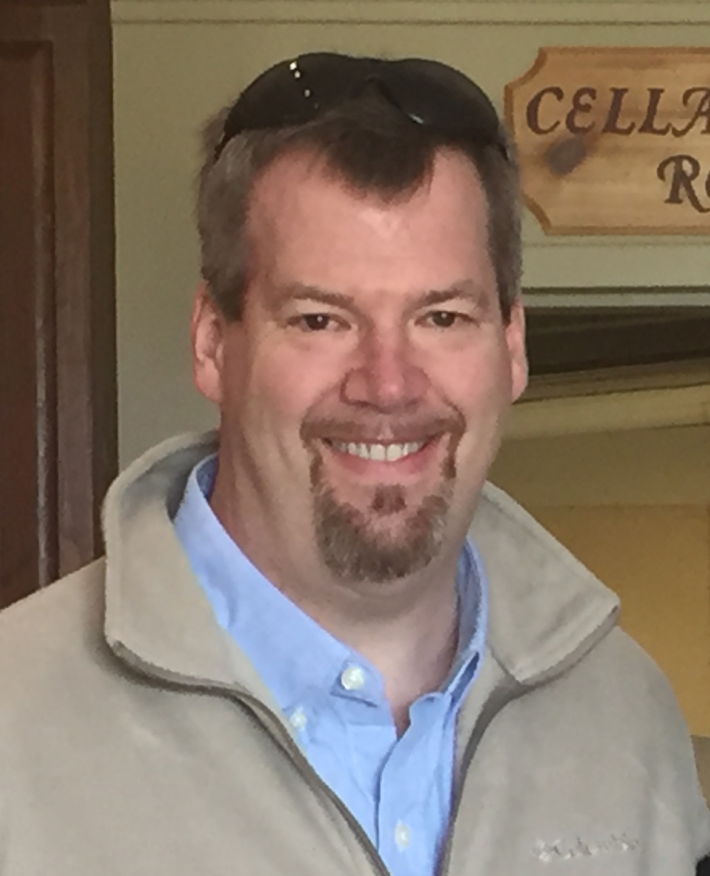
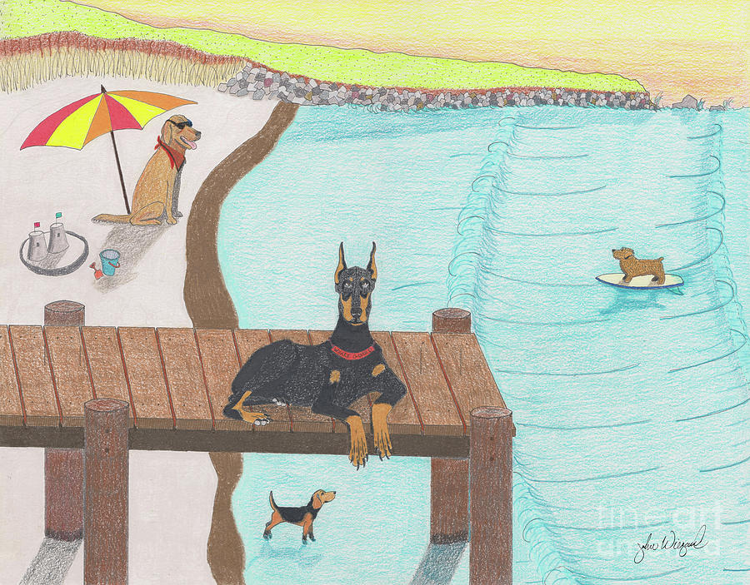
John Wiegand and “Summertime Fun”

Slide 7
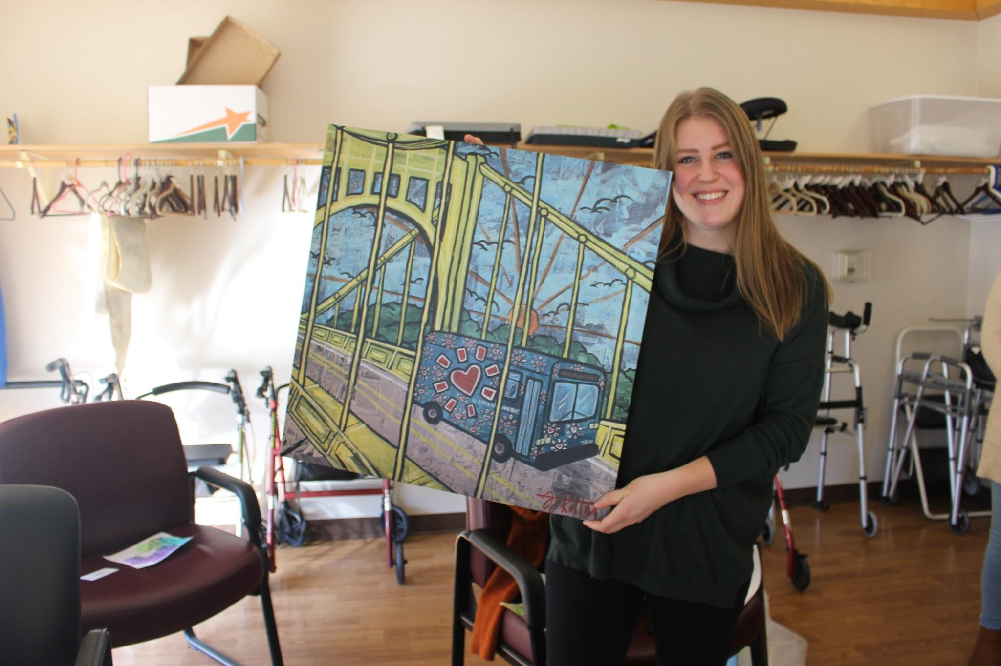
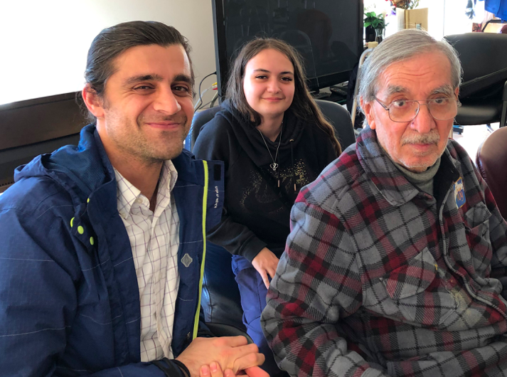
“Spread Love Bus”
Notes:
Now we will walk you through what our sessions looked like at UPMC Canterbury Place and Community LIFE Homestead.
First we introduced ourselves, had them introduce themselves, and then we got into our first art piece, “Spread Love Bus”
For each piece, we walked the piece around and held it closely in front of each participant so they could see the details
We wanted to focus on the present moment, to engage the residents’ senses, and socialization. We were also hoping some participants would be able to relate to the paintings in some way being from Pittsburgh or having a dog or another pet.
We asked the participants to discuss the vibrant colors. “Can you see the comics in the background?” “Do you recognize this bridge / the city?” “What colors stand out to you?” “Did you used to ride the bus to work/school/etc?” “What’s your favorite way to spread love?”
The Community LIFE residents knew immediately that this was the Roberto Clemente Bridge, and we could tell they were excited and proud of Pittsburgh.
Margaret- was a bit grumpy at first, but came around
Edwin- deaf participant
Mary Jane with son
Shallah and son/interpreter
This project is recreatable for everyone! It can be modified so that it can reach people and engage them in a positive way.

Slide 8
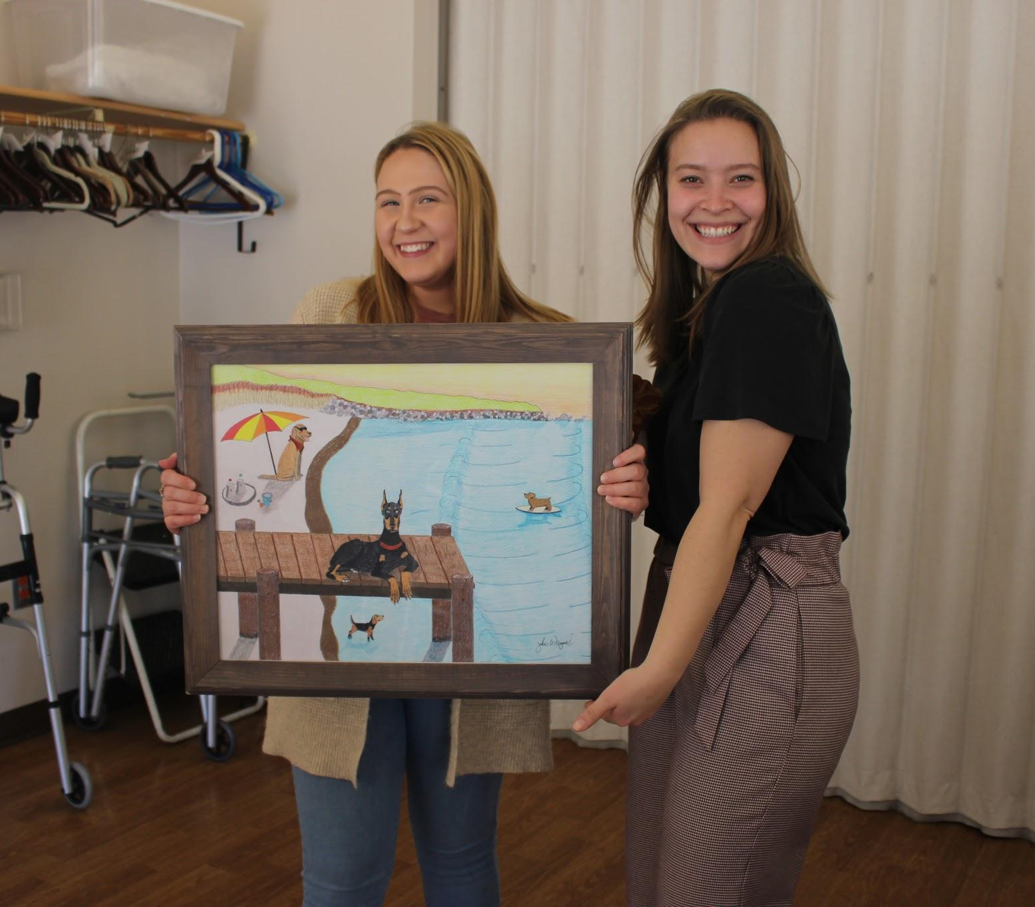
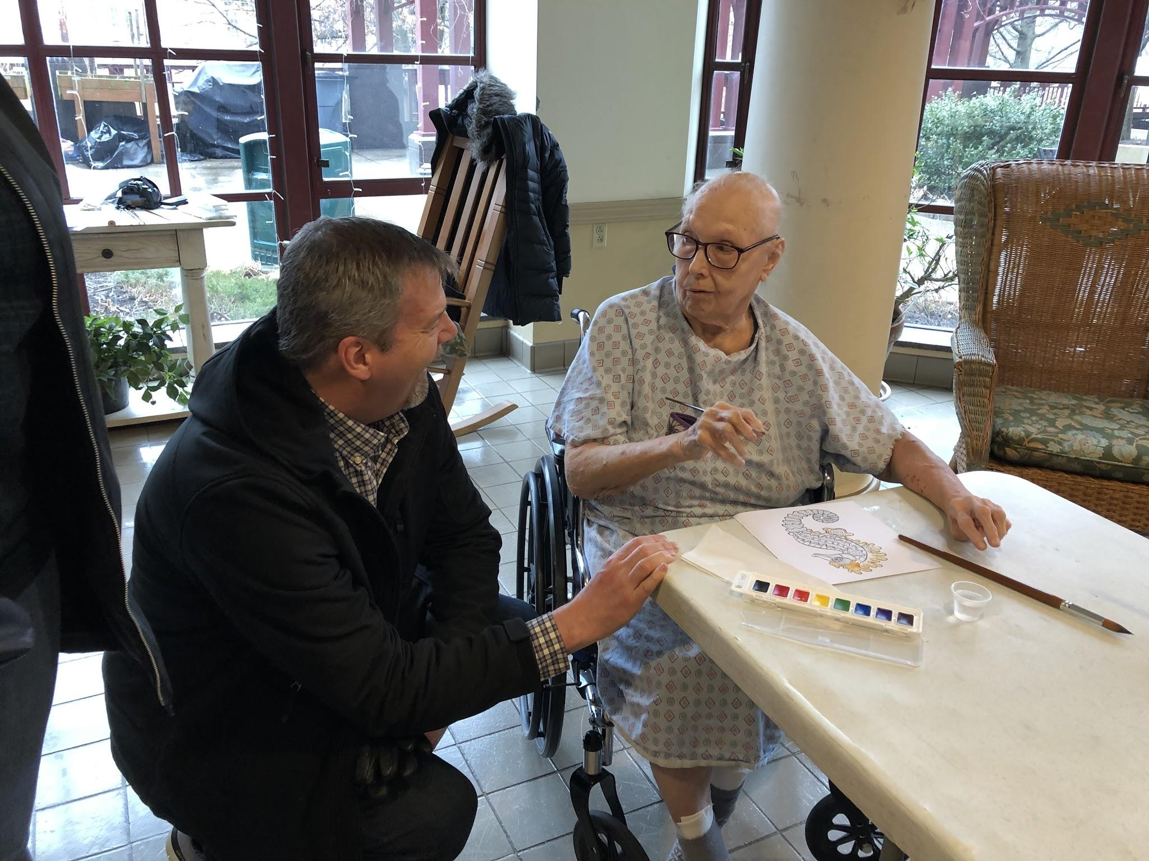
“Summertime Fun”
Notes:
“Which dog do you like best?” “Did you ever own a pet?” “Do you like summertime/the beach or winter time better?” “Do you like big or small dogs?”
John and his wife attended! The picture on the right is him interacting with one of the Canterbury Place residents, Dolores
Dolores’ story: her art exhibited, autographing a piece for John, John seeing her art around the facility
John’s reaction … how he decided to donate the piece, etc.
Geraldine, severe dementia, was able to remember her dogs

Slide 9
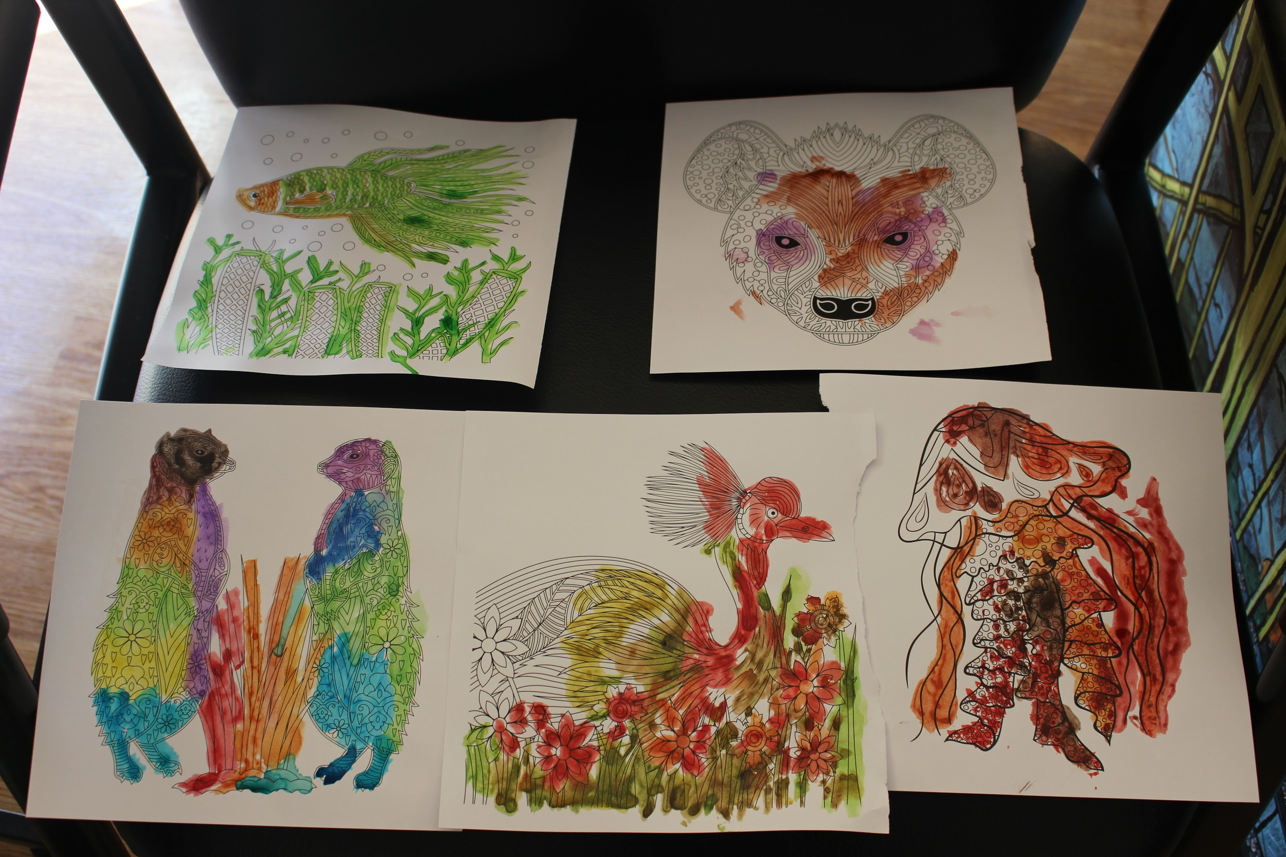
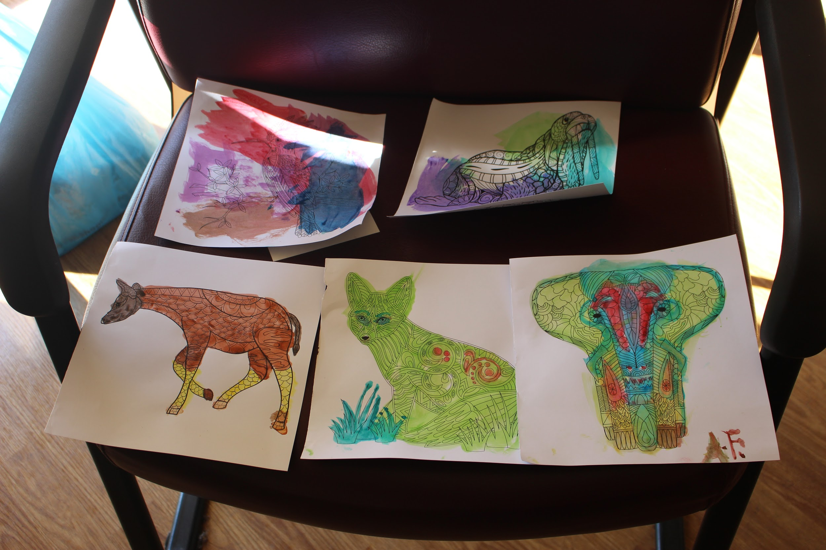
Watercolor and Music

Slide 10
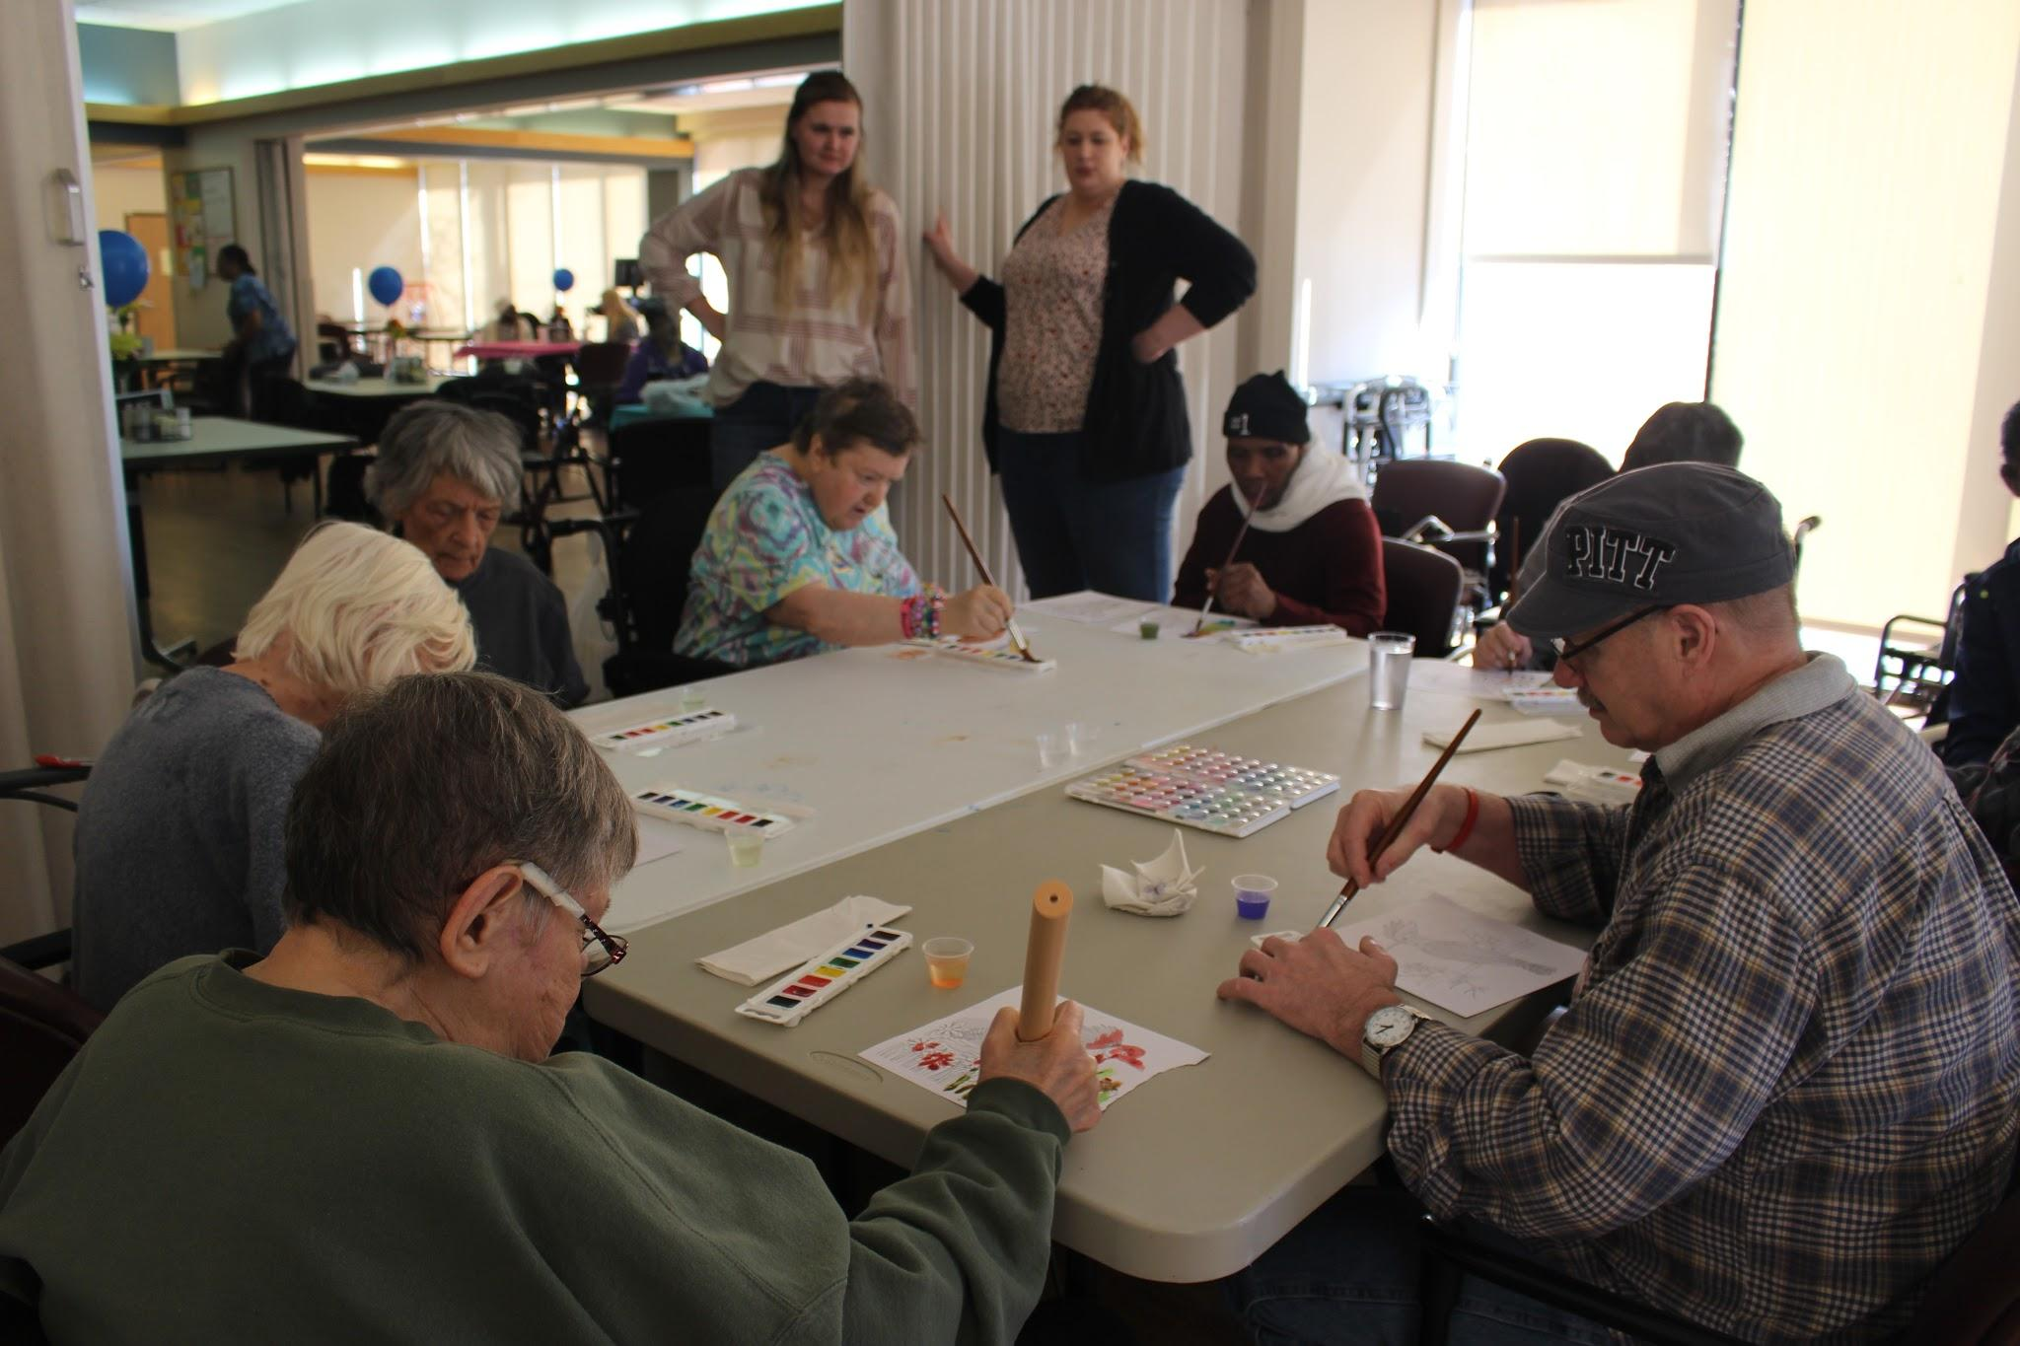
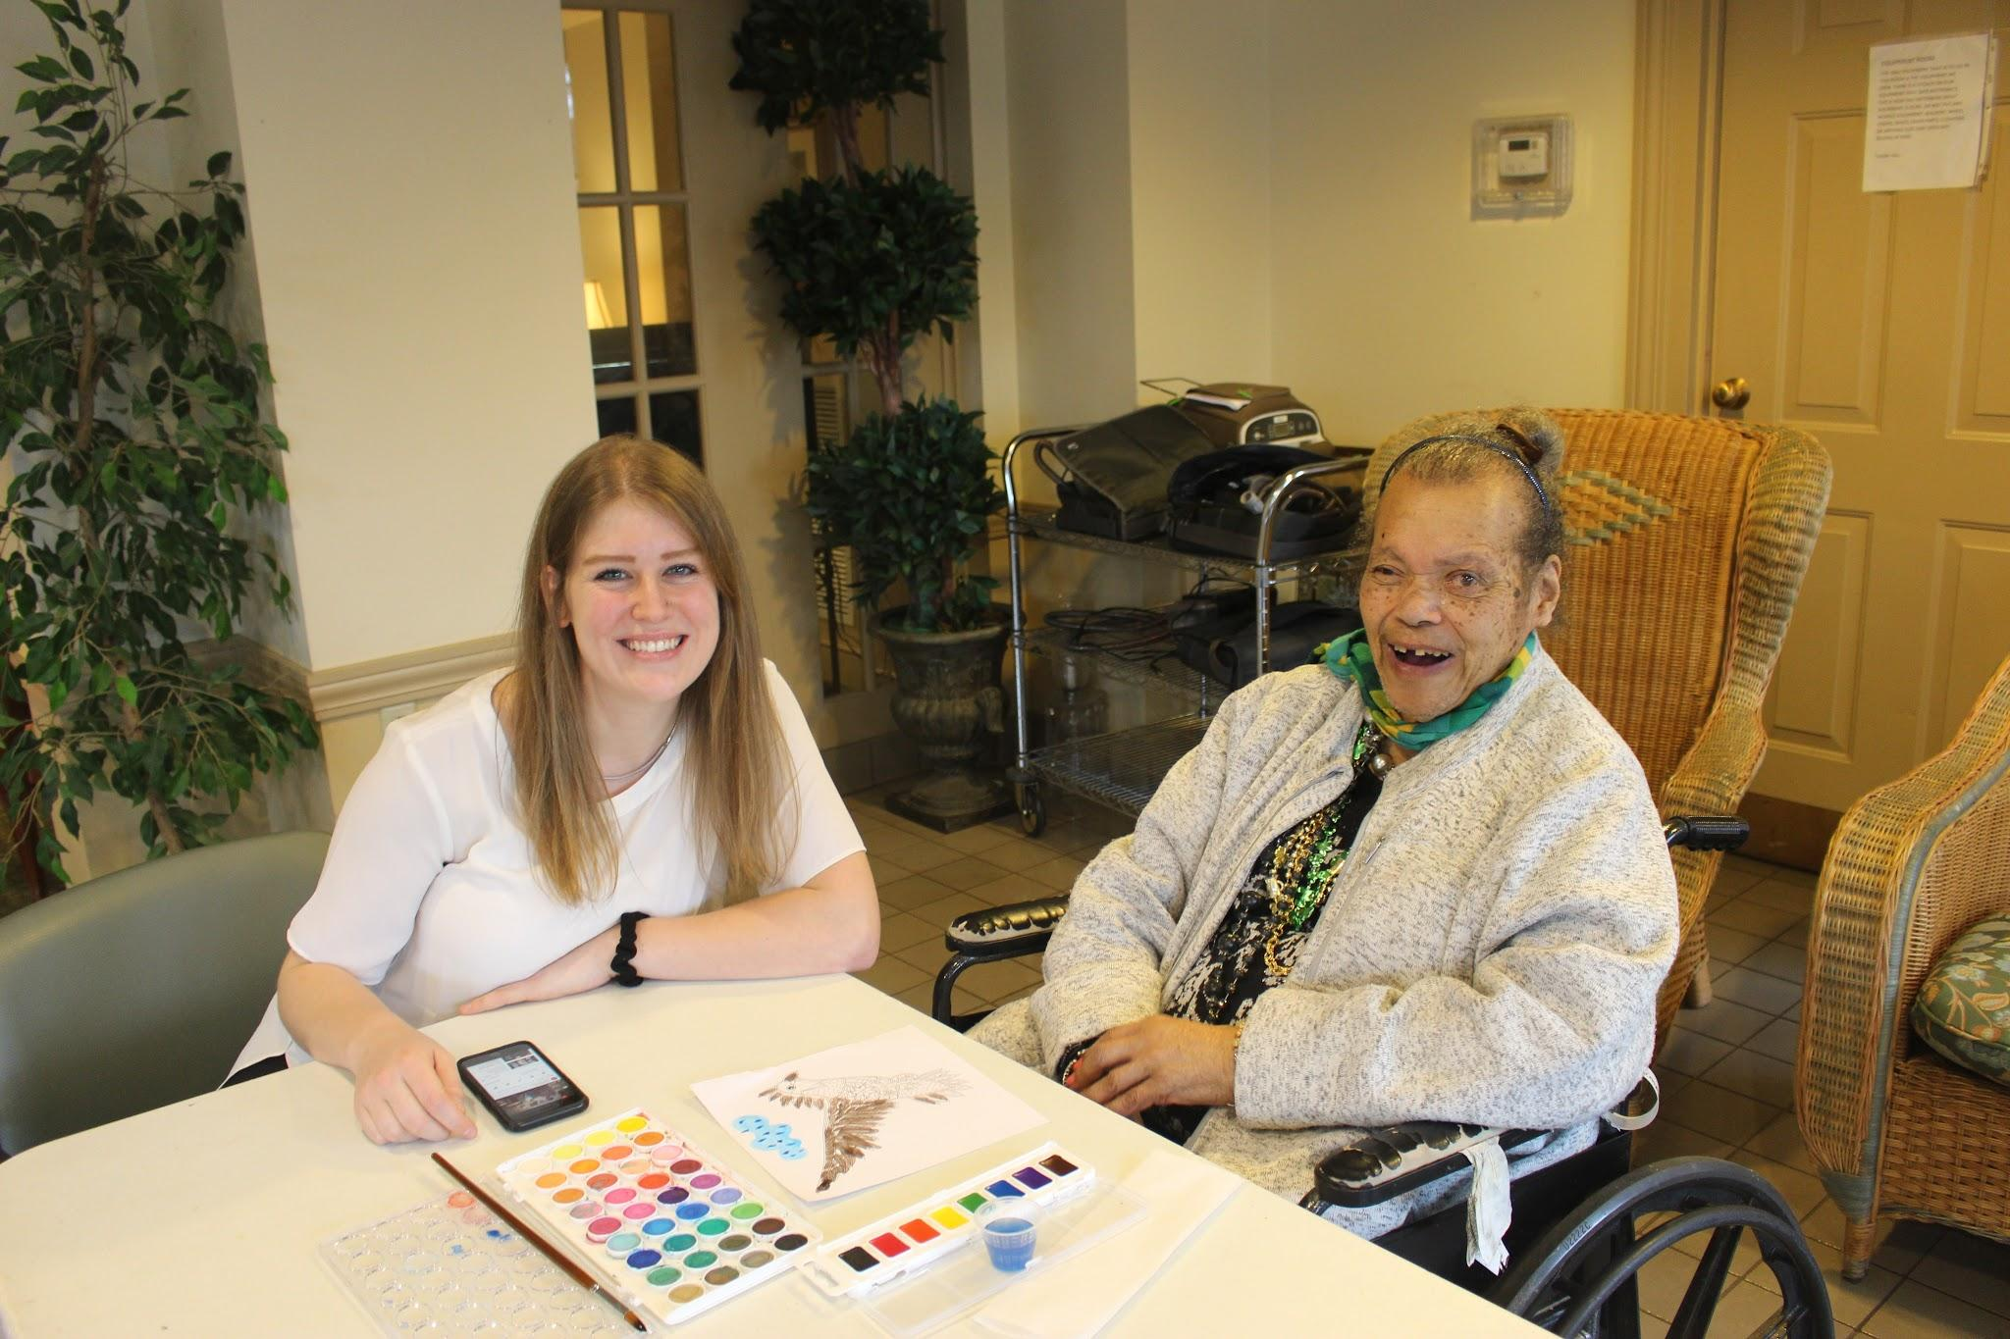
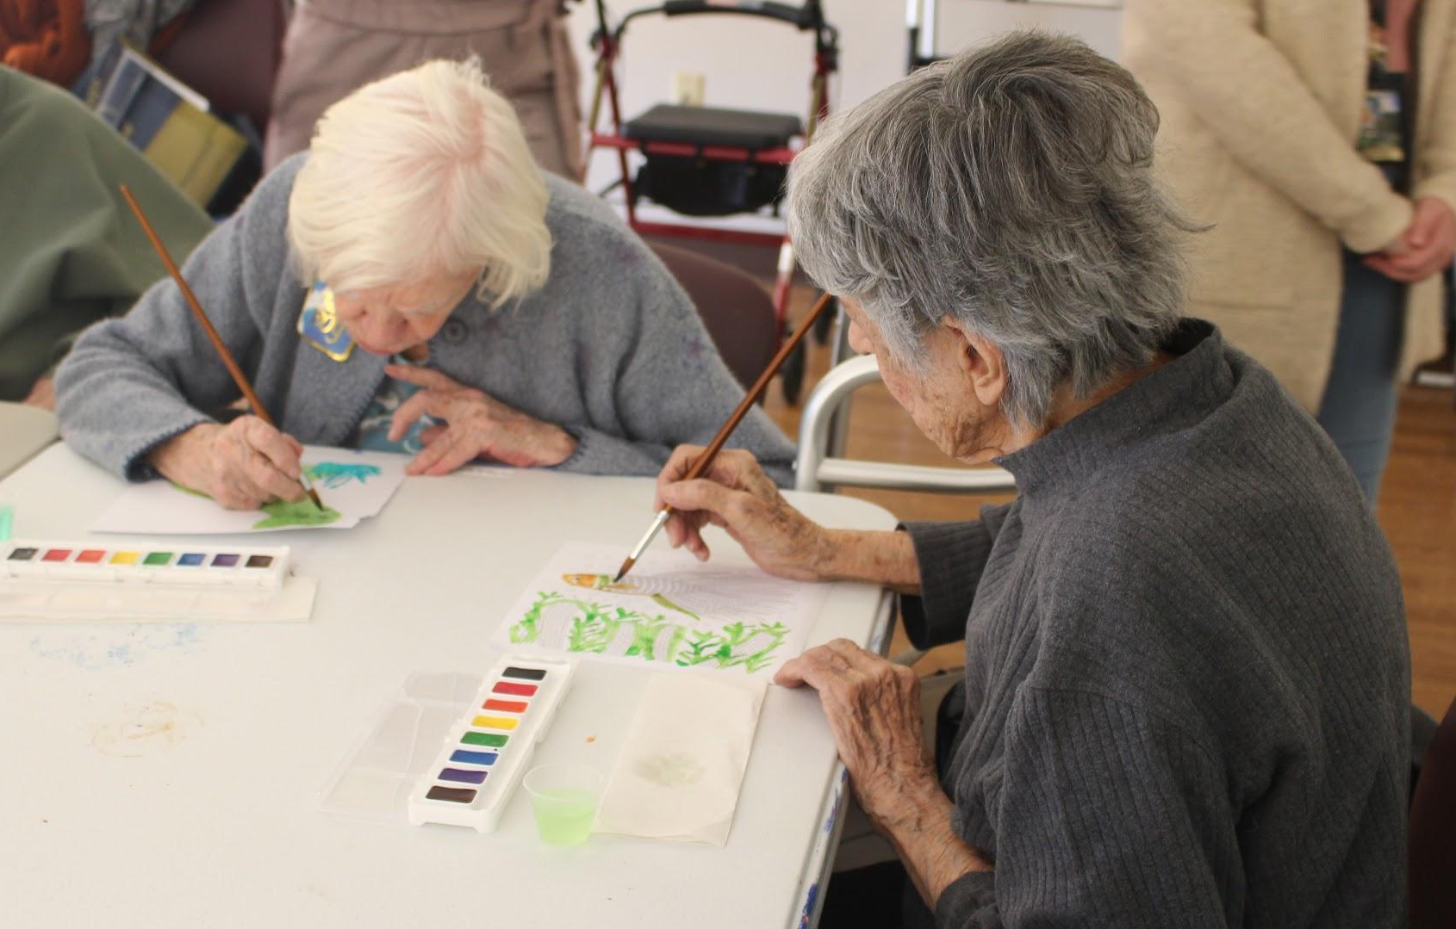
Responses

Slide 11
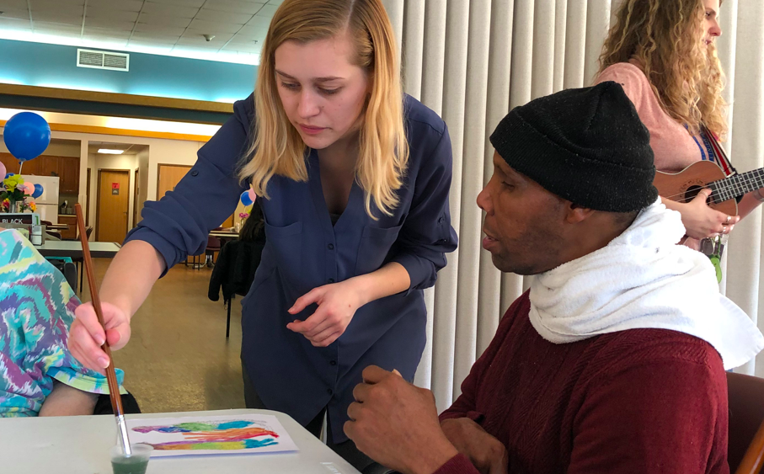
Lessons Learned
Different paint palettes
Pacing
Selecting the paintings
Engaging participants
Art reaches all people!!
In the future
Donate supplies
Community LIFE will do art therapy again
Notes:
One of the lessons we learned in the first session was that we needed individual paint palettes for each person.
We learned more about pacing the event through practice and how to engage the participants.
May not know what is being said 100% of the time and may not remember the actual event, a good moment for them
Selecting paintings- that are large, colorful, subject matter, bringing the paintings around so that people have time to look at it close up
Each session ended up being a little bit different. We had to modify our program to engage each participant- by writing out the information for our deaf participant, for our participant who did not speak English , and by using the thicker paint brushes
Overall, we found that art reaches all people!! All our participants had dementia diagnosis. One of our participants was deaf so we wrote the information down for him. Other participants were hard of hearing. One of our participants did not speak English and had his son interpret for him.
Future/next steps- planned to donate our supplies to the facilities. Community LIFE plans to do the art project again.

Slide 12
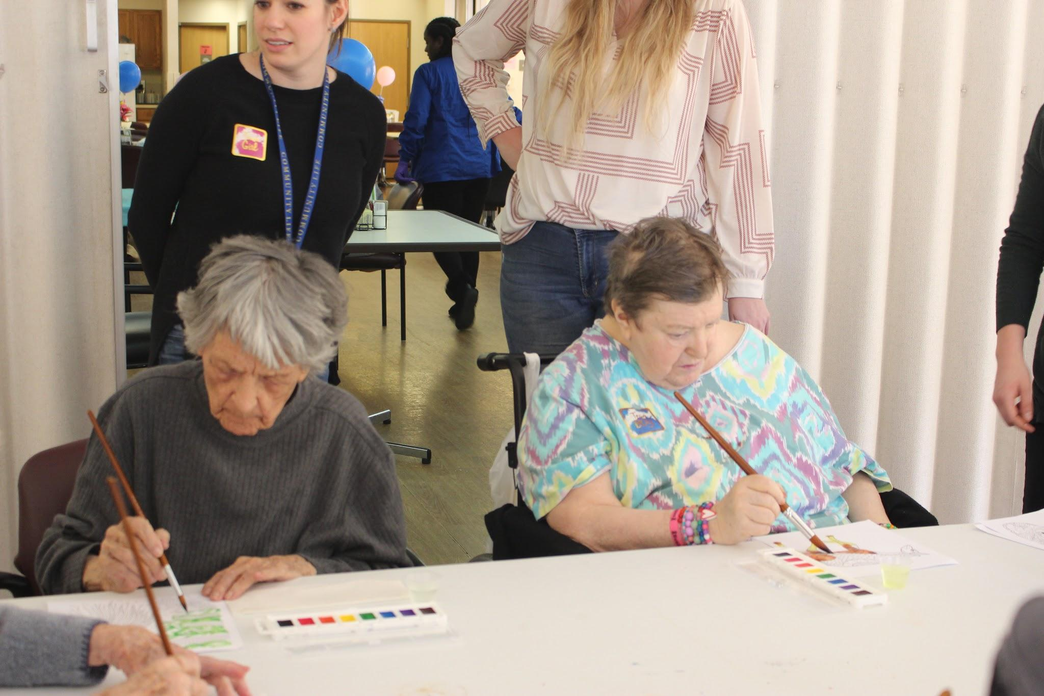
Implications for Social Work Community
Think outside the box!
Utilize art and music
Creating opportunities for engagement
Modifying so that more people can be involved
Self-determination and creativity
The local community can and wants get involved and connected
It does not have to be an expensive project to make a big difference
Notes:
Think outside the box! Be creative with your activities in facilities and in the home. Important to have activities that the person can understand and engage in while still challenging them
Utilize art and music. Research has shown that the creative arts are good for someone with dementia to provide a sense of control, to challenge them, to engage their brain and create new synapses. Can be used as an alternative method of communication and expression
It is possible to modify these activities for more people to be involved. Although museums are putting on good versions of these programs, we wanted them to be more accessible. The people who are unable to travel, tolerate spending a whole day at a museum, and/or be able to afford the cost are often the ones who do not receive enough unique engagement in facilities. It is important to reformat these unique types of programs to bring art and creativity into the nursing facilities to residents who would not get this opportunity otherwise.
Allows residents to use their self-determination and make some decisions for themselves. The ability to make decisions for oneself and to be creative can be unfortunately limited in facilities.
We found that the local community was very supportive. From the Andy Warhol museum to our artists, everyone was willing to help and found mutual benefits from these connections.
Using art does not have to expensive in order to make a big difference! There are free music streaming services online, some with premade playlists from different eras. Recreations of paintings can be found online and be printed instead of using a physical painting. Art supplies can be affordable as well. People may be willing to donate supplies as well!

Slide 13
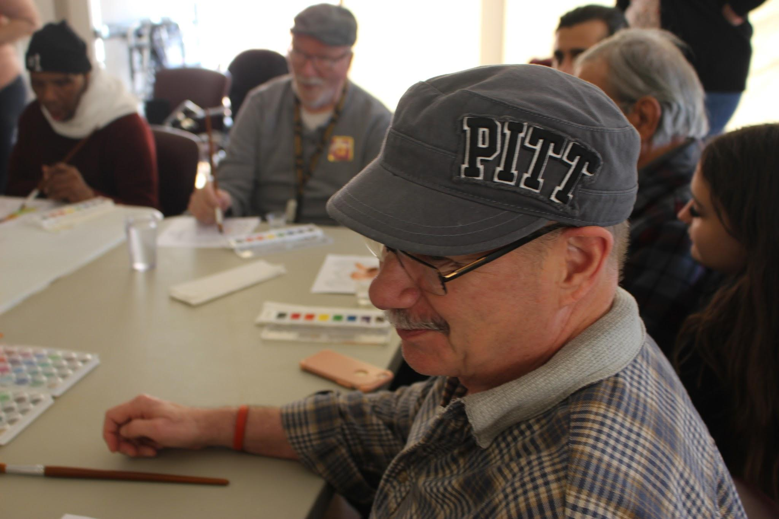
Thank you!
Zachary Rutter
John Wiegand
Year of Creativity
Hartford Partnership Program for Aging Education
Danielle, Paul, and Grace from The Andy Warhol Museum
Participants, Mary, and Christa from UPMC Canterbury Place
Participants, Kara, and recreation department of Community LIFE Homestead
Notes:
A huge thank you to everyone who helped us throughout this project!
Thank you to our artists Zachary Rutter and John Wiegand for providing our art pieces and to John and his wife for attending on of our sessions.
Thank you to the University of Pittsburgh’s Year of Creativity for providing funding for our supplies.
Thank you to the Hartford Partnership Program for Aging Education for running this fellowship project. A special thank you to our advisors Melissa Brusoski and Dr. Ray Engel.
Thank you to the Andy Warhol museum for hosting us for our field research. A special thank you to Danielle, Paul, and Grace.
Thank you to all our participants at UPMC Canterbury Place and Mary and Christa from the activities’ department.
And thank you to our participants from Community LIFE Homestead, Kara, and the whole recreation department.

Slide 14
“People will forget what you said, people will forget what you did, but people will never forget how you made them feel.”
~Maya Angelou~

Slide 15
References
Andy Warhol Museum. (2020). Accessibility. Retrieved from https://www.warhol.org/accessibility-accommodations/
Bruce L. Miller, M.D., professor of neurology and director of the Memory and Aging Center at the University of California, San Francisco
Cohen, D. (2019). Music and Memory Research. Retrieved from https://musicandmemory.org/music-brain-resources/current-research/
Cohen, G.D. (2006). Research on creativity and aging: The positive impact of the arts on health and wellness. Generations, 30(1), 7-15.
The Museum of Modern Art (MoMA). (2009) The MoMA Alzheimer’s Project: Making Art Accessible to People with Dementia. Retrieved from https://www.moma.org/visit/accessibility/meetme/_assets/momaorg/shared/pdfs/docs/meetme/MeetMe_FULL.pdf

