Slide 1
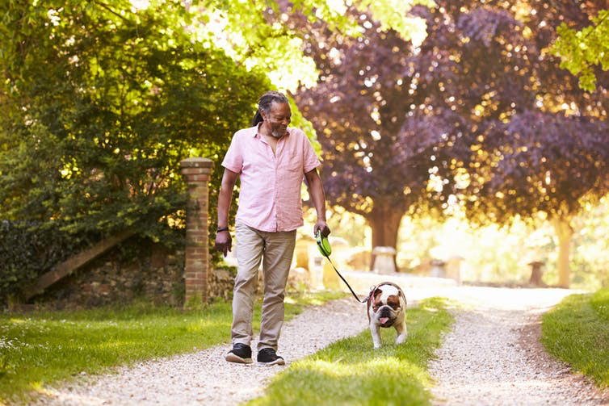
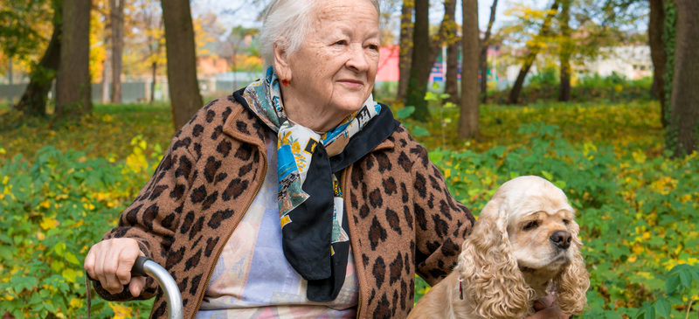
Aging in Place with Pets
Hartford Partnership Program for Aging
Kelsey Reich, Ionie Evans, Elizabeth Steiner, Claire Engels and Alex Hickman

Slide 2
Contemporary Considerations for Aging Together with Companion Animals
Rauktis, Lee, Bickel & Cahalane, 2019
Over one-third of older adults in Western countries live with a companion animal (Toohey & Rock, 2019)
7.7% of individuals 60 and older are food insecure (Feeding America, 2017)
Limited research on low-income pet owners and food security
Study included surveys and interviews of 390+ people at 30 food pantries
Food security, food strategies, benefits and challenges, and more
Notes:
Survey Sample
N= 175 age 60+
Mean age = 68
60% white
71% female
59% at least one companion animal
Interview Sample
N = 8 age 60+
Majority female
All had one or more pets

Slide 3
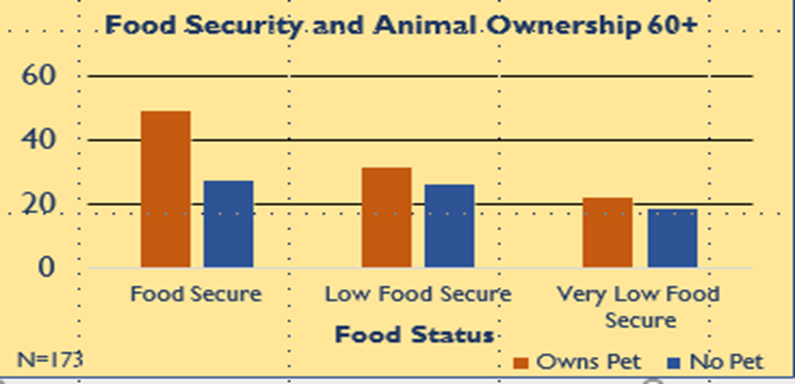
Are older low-income pet owners more or less food secure?
Older adults with companion animals may be more food secure even though they share food with their pets
Notes:
Controlling for race, education, employment, marital status, gender, income and benefits, multiple regression analysis found that :
Older age associated with greater food security p=.05
Pet ownership associated with greater food security p=.01
Low income associated with lower food security p=.05
Sense of purpose, motivation for self care
Challenges: anticipatory worry and anxiety, perception of limited housing options with pets

Slide 5
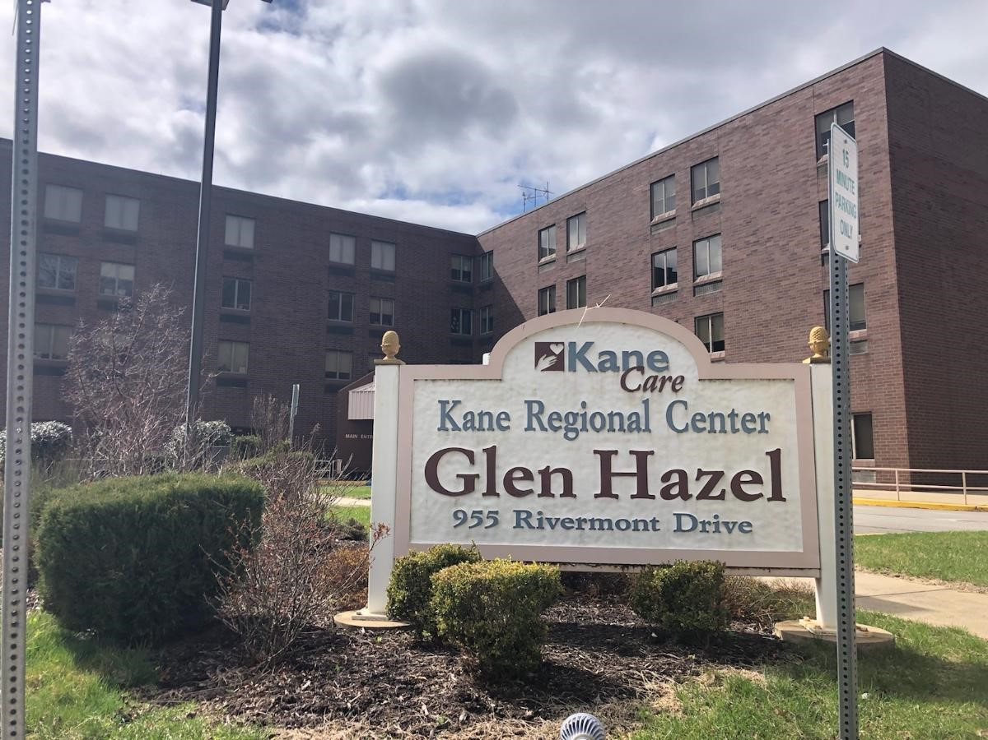
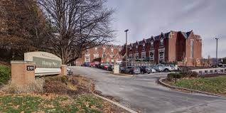
Notes:
All conducted informal interviews and participant observations at out Field Placements
AgeWell; brought in service dogs from animal friends and there was a huge turn out. seniors there mostly did not have pets but wanted them. Their main concern was that they did not know if they could handle it with their own medical conditions
Assessments don’t include pets, but when asked if they eat alone/with other people, most answer was with a pet!
EAAS; older man came in, dog just died, wanted to adopt a new one, but did not have a car and could not take any animal on senior transportation options, lonely
Canterbury Place: PTs, nurses seeing falls from pets
Kane Regional Center
Heritage Place

Slide 6
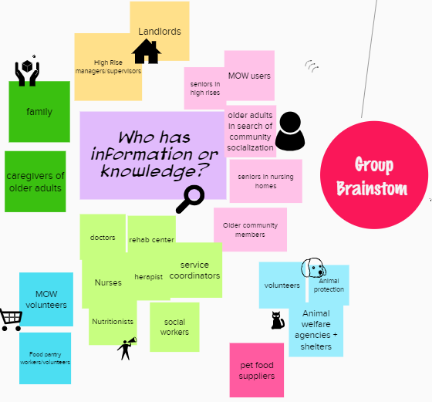
How can we make this information available?
Create a resource guide for older adults aging with pets!
Notes:
We realized that a lot of older adults do age with pets or would like to - however professionals also acknowledged the risks of doing so. Also - this information is not readily available to help older adults with pets. For example - the Allegheny County Senior Resource Guide doesn’t have a section dedicated to animals or pets. Some older adults could benefit from having a pet, but need some extra help or need some more information to help support them. They may not be aware of resources available to them.

Slide 7
Aging in Place with Pets: A Resource Guide
Notes:
We worked to put together a resource guide with three distinct sections

Slide 8
Section I: Introduction & Background
Can Aging With Pets Make Life Happier For The Elderly?
Notes:
In our first section we consider the question “Can aging with pets make life happier for the elderly?”

Slide 9
“The number of Americans ages 65 and older is projected to nearly double from 52 million in 2018 to 95 million by 2060, and the 65-and-older age group’s share of the total population will rise from 16 percent to 23 percent. (Mather, 2019)
Notes:
The older adult population is growing and in most developed countries, such as America, they are living for much longer. Many for up to 80 plus years without suffering from any significant health related disabilities This in turn has maximized the quality of their years after retirement.

Slide 10
Benefits of aging with pets
Pets can motivate people to be active.
Pets can stimulate positive emotions.
Living with a pet provides company.
Pets can offer emotional support.
Pets can help in establishing a structured daily life.
Notes:
Through research we have seen that there are many positive strategies for maintaining beneficial pet ownership and human animal interaction for older adults.

Slide 11
Some risks and challenges related to pet ownership in older adulthood
Pet ownership costs money.
Pet ownership is not a uniformly desired or positive experience.
Inability to provide adequate care for a pet.
Extreme attachments. Ex. Hoarding
Notes:
On the other hand also, there are also some disadvantages to owning a pet as a older adult.

Slide 12
Section II: Living safely with your pets in your home

Slide 13
Advanced Planning For Pets
Where will your pet go in emergencies ?
When it’s time to give up your pet?
Notes:
needs info on Advanced Directive practices, how to have tough conversations before its time to give up pet, having neighbors/friends/family members in place in case of an emergency, for example some apartments we talked to said they must have 3 people identified to take pet in order to have one

Slide 14
Hiring Help
Training your pet
Clearing your space
Notes:
Alex, can you add your tips and tricks

Slide 15
When is it time to rehome your pet?
Three or more hospital visits
Is it safe to have a pet at your home?
No
|
No support
|
Could you find community support?
|
No
|
Rehome
Yes
|
Family or caregiver can help
Maybe
|
Family or caregiver willing to help
Notes:
Talking points, how do you begin conversation

Slide 16
Section III: Community Resources

Slide 17
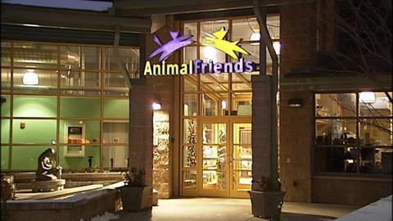
Community Partners
Notes:
We visited and took a tour of both Animal Friends and Humane Animal Rescue. We talked with Liz Moser from Animal Friends who offered us resources on food banks, low cost vet care and introduced us to Chow Wagon. Madeline Daschbach offered us housing resources and information about the need for rehoming pets and having an emergency plan. They helped us identify gaps in the community and what their clients need the most, which helped us identify our community sections.

Slide 18
Food
Housing
Low-Cost Vets
Emergency Boarding
Transportation
Food Pantries across Pittsburgh area that have dog food available - largely supplied by Animal Friends Chow Wagon
Contacted Senior Apartment buildings from Senior Resource Guide. List of 70+ buildings and their pet policies
Includes access to both low-cost vaccine and low-cost spay/neuter services
Important resource for older adults who may unexpectedly go into the hospital and do not have family or friends to take pet
Many older adults no longer drive and pets are not allowed on Access or Port Authority unless a certified service animal
Notes:
Many of these resources came from Animal Friends and Humane Animal Rescue

Slide 20
Partnership with Pitt Business Students from the David Berg Center for Ethics and Leadership

Slide 21
Pitt Business Student Involvement
Pitt Business student consultants from the Certificate Program in Leadership & Ethics worked with the Hartford students, as well as Liz Moser from Animal Friends/Chow Wagon
For Chow Wagon, they created a Best Practices Report about community based programs, from which Chow Wagon could implement ideas from
For the Hartford students, they hosted a one-hour marketing session to develop
A logo
Potential distribution sites
Format ideas
With the help of Professor Ray Jones, they also provided a scalability report for the development of the resource guide into an mobile application

Slide 22
In Conclusion

Slide 23
What We Learned
Identified gaps in service delivery
Transportation
South Pittsburgh pet friendly housing
Pet questions rarely included on assessments
There is an overall lack of streamlined information about pet resources for older adults
Seniors biggest concerns are food access and their own mobility
Overall, we believe seniors can age safely with pets, but need knowledge of the resources available!
Notes:
Not a lot of low cost transportation options, are some taxi services but are pretty expensive
There was not one localized place that seniors had about pets, not in senior resource guide

Slide 24
Moving Forward
Product Design
Allegheny County Senior Resource Guide
Identify Distribution Sites
Business students
Caretakers, senior centers, community centers, nurses, vets
Digital version
Must be accessible for seniors
Advocacy for adding pet questions to biopsychosocial assessments for older adults
Notes:
We have spoke with ACSRG, who said they accept edits to their 2021 version of the guide
The business students are working on a scope of work, to identify the most accessible distribution sites for a resource guide
Creating a digital version so it can reach older adults who are not as connected in their community
Work w/ animal friends and professor rautkis, having it at animal friends/rescue league
App for caseworkers, bring up list of housing

Slide 25
Acknowledgements
THANK YOU to those who helped along the way:
Professor Mary Rauktis
Melissa Brusoski
Dr. Ray Engel
Liz Moser and Animal Friends
Madeline Dresbach and Humane Animal Rescue
Dr. Ray Jones, Carolyn Zedalis, John Frankford and Bianca Reyes from Pitt Business
Hartford Foundation

Slide 26
Works Cited
Batty G David, Z. P. (2017). Associations of pet ownership with biomarkers of ageing: population based cohort study . BMJ , 1-6.
Enders-Slegers, M. &. (2019). Pet Ownership and Human–Animal Interaction in an Aging Population: Rewards and Challenges. Anthrozoös, 225-265.
Fox M, R. M. (2019). No pets allowed? Companion animals, older people and residential care . BMJ Journals Medical Humanities , 211-222.
Heuberger, R. &. (2011). Characteristics of ageing pets and their owners: Dogs v. cats. . British Journal of Nutrition, , S150- S153.
Mein, G. G. (2018). A cross-sectional exploratory analysis between pet ownership, sleep, exercise, health and neighbourhood perceptions: the Whitehall II cohort study. . BMC Geriatrics, 1-9.
Resnick, B. (2019). Can pets help make aging better? What do we know and believe? Geriatric Nursing Journal, 121-122.
Toohey, A. M., Hewson, J. A., Adams, C. L., & Rock, M. J. (2018). Pets, Social Participation, and Aging-in-Place: Findings from the Canadian Longitudinal Study on Aging. Pro Quest, 200-217.
Mather, M. S. (2019, July 15). Population Reference Bureau, Aging in the United States Fact Sheet. Retrieved from prb.org/aging-unitedstates-fact-sheet/: https://www.prb.org/aging-unitedstates-fact-sheet/

